Slide 1
Precomputed Lighting Advances in Call of Duty: Modern Warfare
Peter-Pike Sloan, Ari Silvennoinen

Slide 2
Acknowledgements
Studios: Infinity Ward, Sledgehammer, Raven, High Moon, Beenox
Lighters: Dave Blizard, Vivian Ding, Leandro Do Amaral, Rachel Donnelly, Christina Ellerby, Samuel Fradette, Alberto Noti, Angel Orlando, Andrew Prince, Velinda Reyes, Luka Romel, Marko Vukovic, Krzystof Wojcik
Developers: Danny Chan, Michal Drobot, Stephanus Fnu, Peter Pon
CT: Adrien Dubouchet, Aki Hogge, Michal Iwanicki, Jorge Jimenez, Josiah Manson, Dario Seyb, Andrew Shurney, Michael Vance
Notes:
Before I start, a lot of people worked on the game, way more than can easily be named here.
We work with multiple studios, and I wanted to call out the lighters (some from an earlier game I will talk about) and developers we have worked closely with.
Back pre-covid we worked in something called an office and would frequently brainstorm with people in Redmond and other central technology locations.

Slide 3
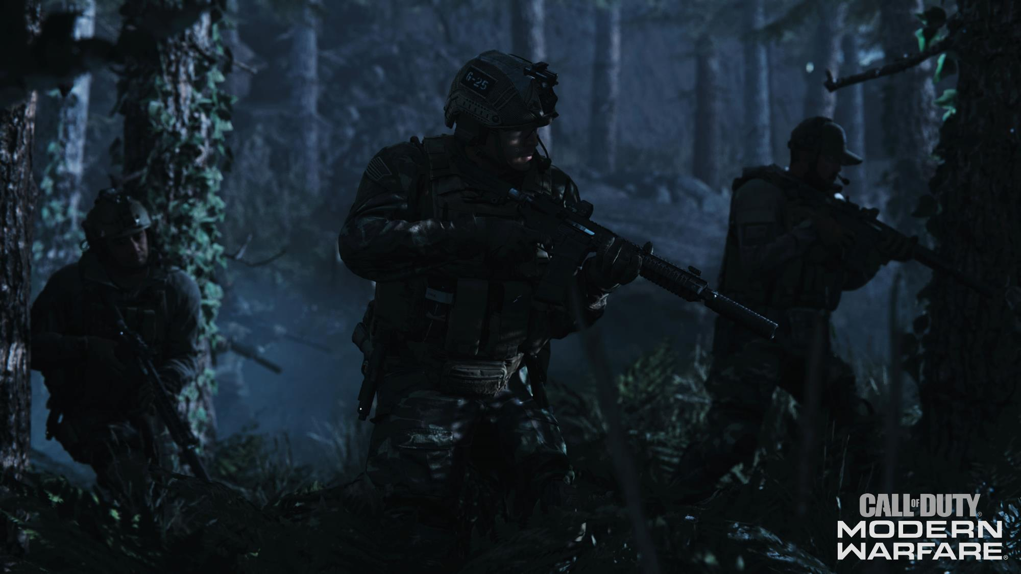
Notes:
Call of Duty: Modern Warfare is a 60hz Forward+ game. Our talk focuses on lighting.
Going into this game, there were some unique challenges that put pressure on the lighting system:
We had many night levels, that are notoriously difficult to make look good. They are much more sensitive to noise when computing global illlumination compared to well lit or daytime maps.

Slide 4
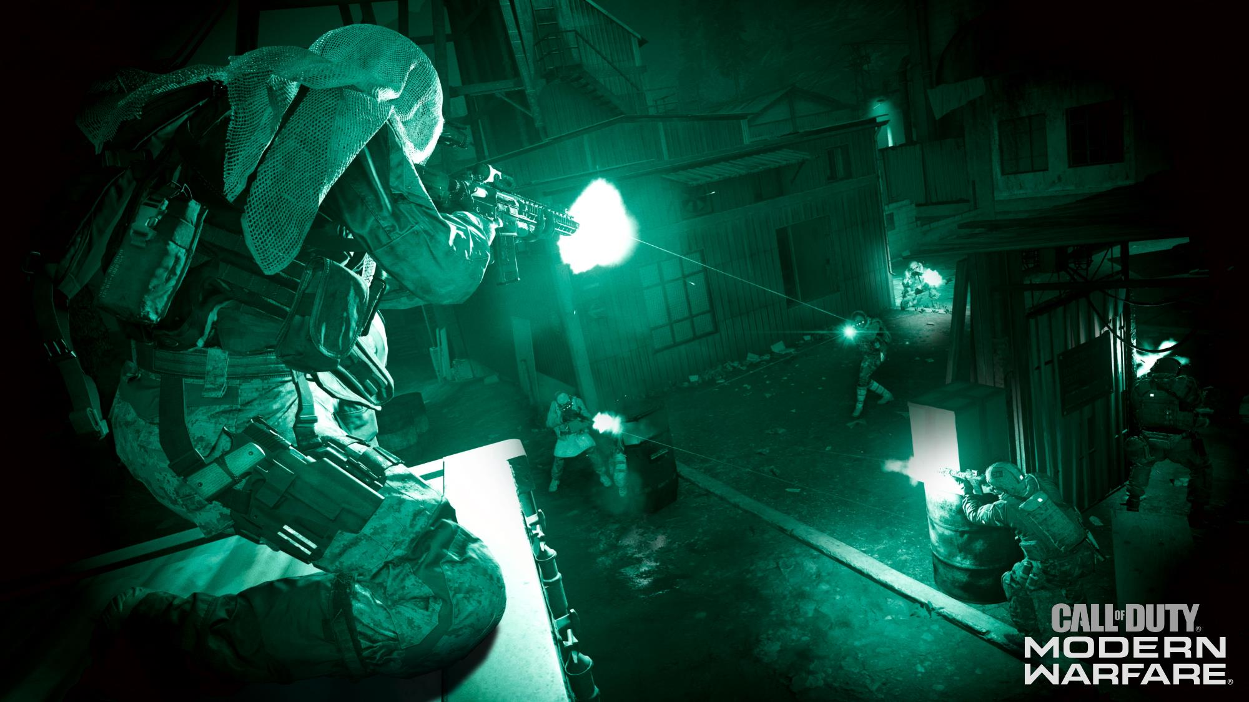
Notes:
We have a fair amount of stealth game play mechanics, that required the player to shoot out or shut off lights, forcing the player to use night vision goggles. This was in both the campaign and some MP levels.

Slide 5
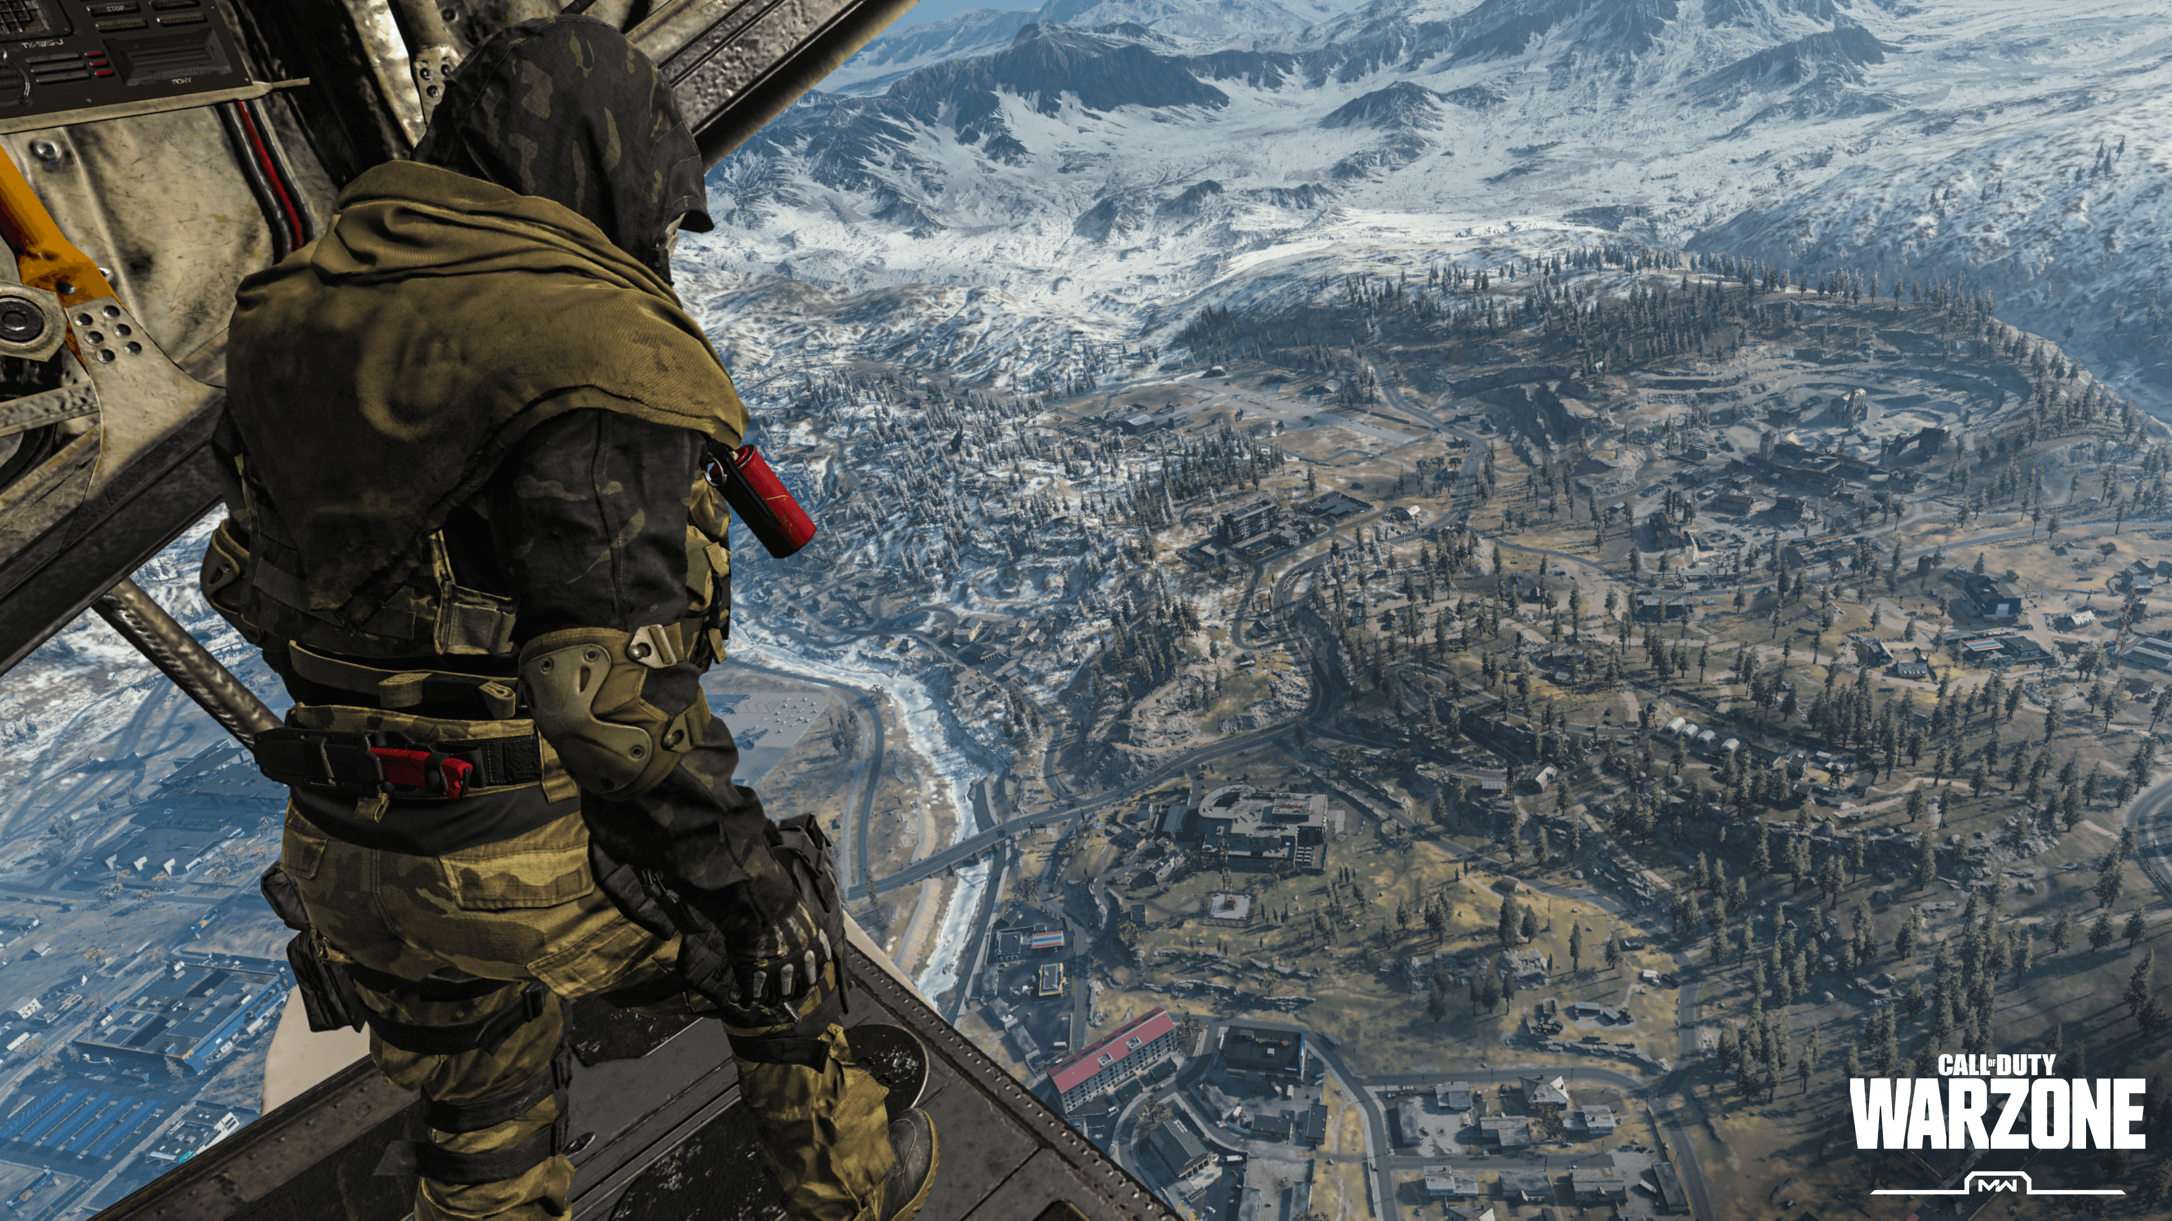
Notes:
You would think that would be difficult enough, we also introduced warzone, that was *way* larger than anything we had handled before in this baking pipeline. Call of Duty games traditionally are about tight close quarters combat, so this is a large departure for this codebase.

Slide 6
Overview of Talk
Generic Baking Improvements
Emphasis on how things changed since [Iwanicki17a]
Spherical Harmonic (SH) encoding
Focus on insights about spherical harmonics
New Linear SH Reconstruction Algorithm
Dynamic Lightsets Implementation Details
See technical paper for system, sampling details [Seyb20]
Notes:
The rest of the talk is really in four sections.
I will first talk about generic baking improvements, with an emphasis on how things have evolved since we last talked here about Call of Duty: Infinite Warfare.
Then I will talk about our Spherical Harmonic (SH) encoding, where the focus will be trying to give insights into why it works and some properties of SH in general.
Then I will discuss a new reconstruction algorithm for linear SH.
And finally go into some implementation details on how we support limited GI updates. This complements the paper and Darios talk on the systems paper, focusing on implementation details and some lessons learned as we deployed this.

Slide 7
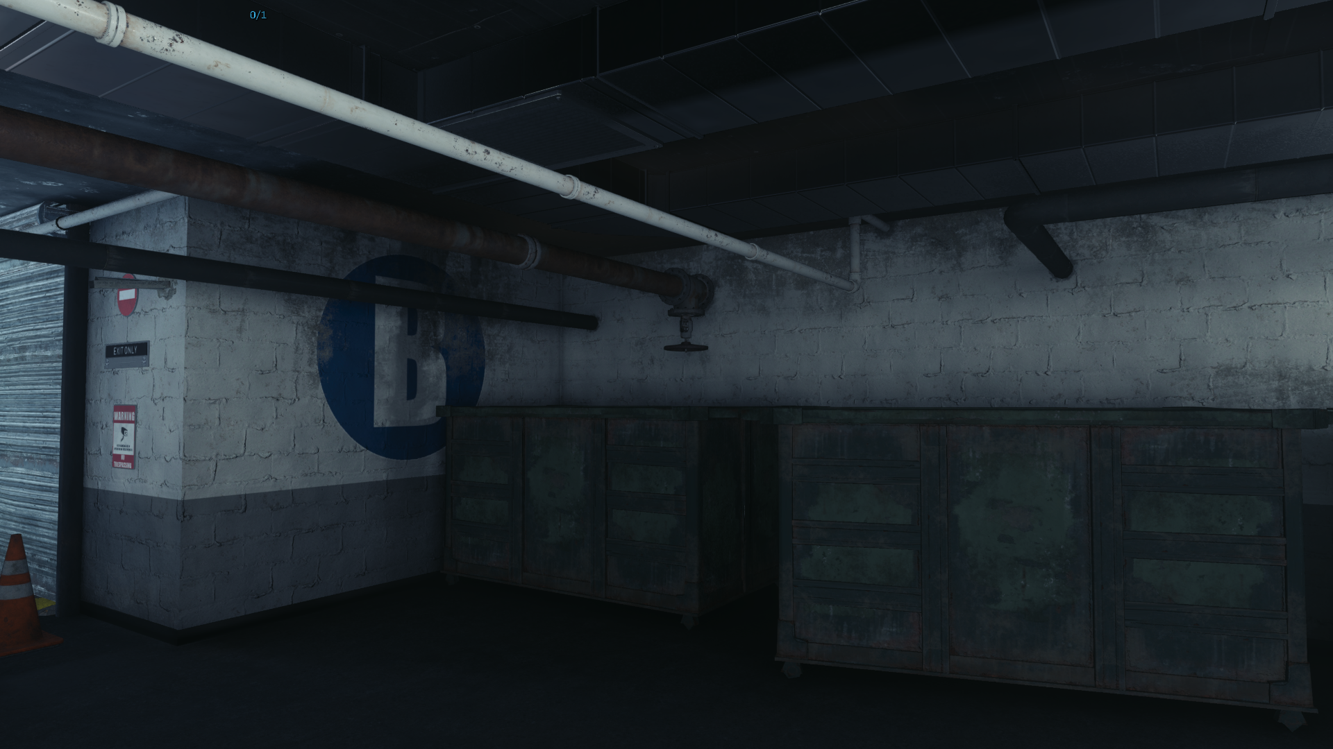
© 2019 Activision Publishing, Inc.
Notes:
Here’s an in-game image from one of our campaign levels. Like in previous games we have 3 different representations of baked lighting.

Slide 8
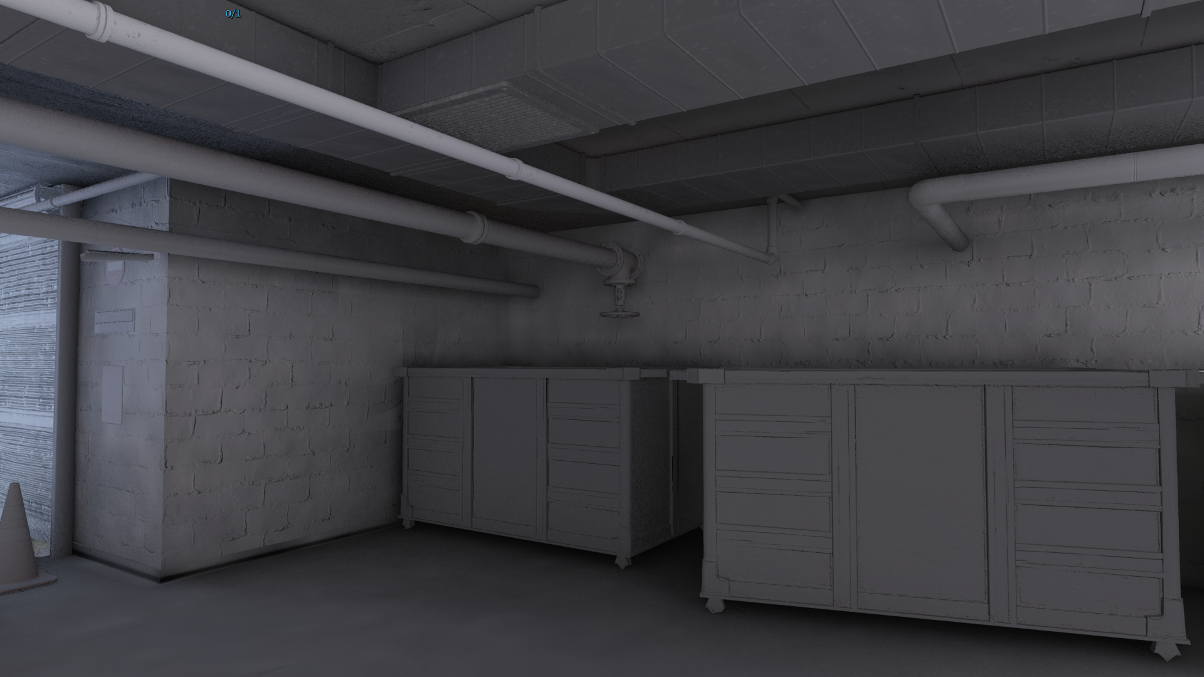
LM Lightmap
LGV Lightgrid Volume – static
© 2019 Activision Publishing, Inc.
Notes:
The yellow areas are using lightmaps and the cyan areas are using light probes for static models. The lightmaps encode hemispherical directional incident radiance, they are generally used for walls, and large structural models. LGV’s store spherical radiance functions and are used for models.

Slide 9
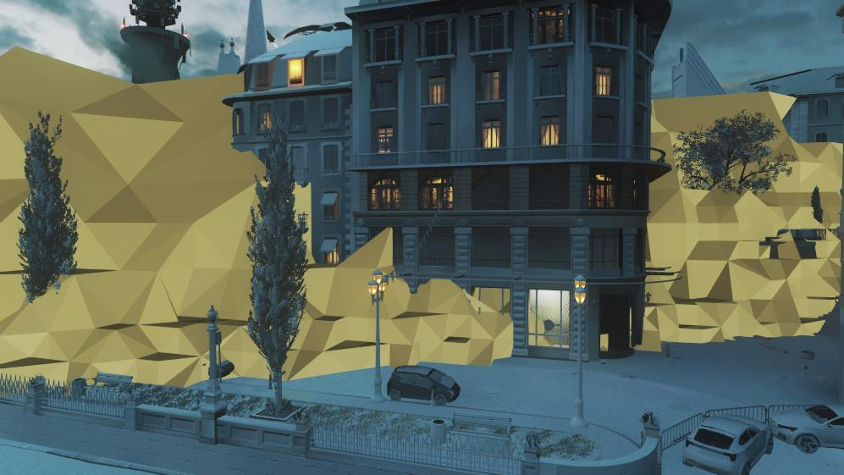
[Iwanicki17a]
LM Lightmap
LGV Lightgrid Volume – static
LG Lightgrid - dynamic
© 2019 Activision Publishing, Inc.
Notes:
For dynamic models, we retain the same adaptive tetrahedral data structure used in earlier games, except the memory for the SH data is cut in half. This is resampled to LGV’s every frame and render using the same code path as static models otherwise.

Slide 10
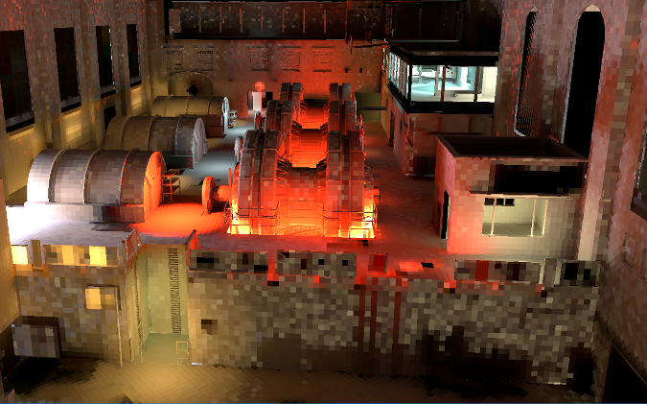
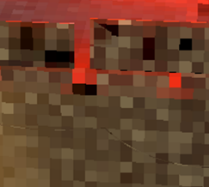
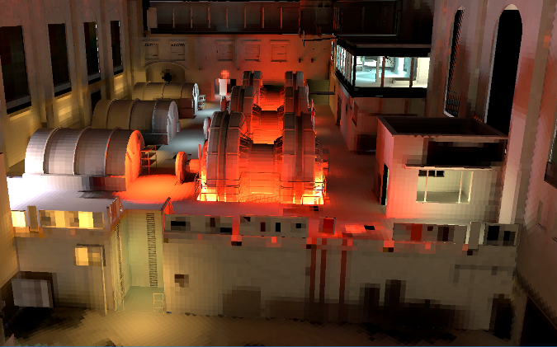
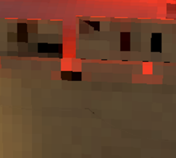
Generic Baking Improvements
Ray Guiding [Ari19]
LM only
Retrace Sun (Ari)
Large Maps
Skylight (Ari)
Last LOD
Streaming (Iwanicki)
LG, LGV, LM
Lighting Consistency
Stitching Models
Merging Models
“Thin” Models
Lightmap Encoding [Sloan18]
Notes:
I will first touch on some generic baking improvements, some of these have been or will be covered in more detail in other presentations, I will use square brackets for actual papers/write ups, and parentheses to credit people where a write-up doesn’t exist yet.
Ari published a technical brief at SIGGRAPH Asia last year on using ray guiding to improve the quality of our lightmaps (equal bake time images shown – ray guiding converges much quicker than uniform sampling at the same cost – depending on the map it is often 2-10x better). This was critical for the dark maps in particular, where illumination is very localized. One important difference compared to much of the path guiding literature is that the data-structures / PDF’s needed for ray guiding were never stored in a global data structure, they would always be produced and consumed within a thread working on blocks of texels. This made it easier to scale – it didn’t have any memory pressure and there was no synchronization between threads. See the paper for details.

Slide 11
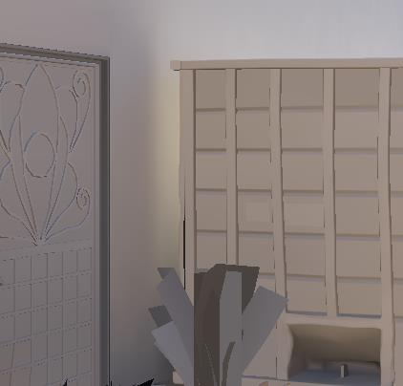
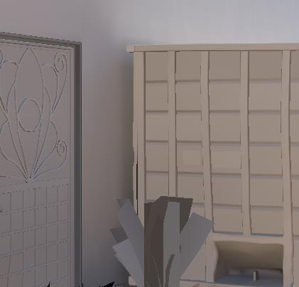
Retracing Direct Light
Ray Guiding [Ari19]
LM only
Retrace Sun (Ari)
Large Maps
Skylight (Ari)
Last LOD
Streaming (Iwanicki)
LG, LGV, LM
Lighting Consistency
Stitching Models
Merging Models
“Thin” Models
Lightmap Encoding [Sloan18]
Notes:
We use a series expansion baking pipeline, which caches the lighting in the same data structures we render with in the game. This significantly helps with performance, re-using all sub-paths. For lightmaps this works very well, but for models the sampling density is low – often a handful or probes. They are primarily designed for storing indirect light, so harsh direct light like the sun can cause a light leak through the data structure.
The solution Ari came up with is to resample the sun when we hit models instead of caching. This has a small cost and while the result is often subtle, it does help a lot.
The top image is without retracing, the bottom images with it enabled, the shipping container is acting like a tunnel causing a false bounce on the wall behind it.
The red circle is “bad” and the green is “good”, I will be using this convention on the next handful of slides.

Slide 12
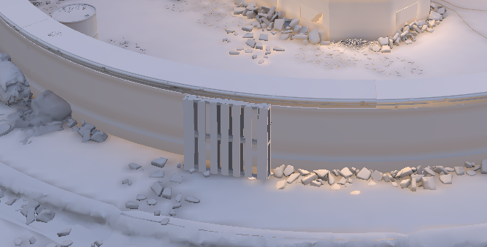
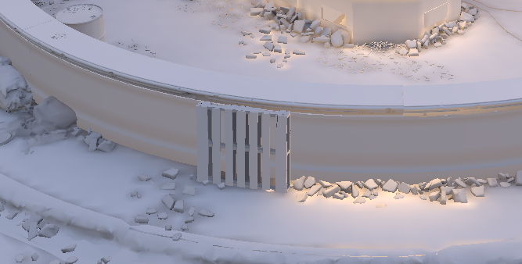
Retracing Direct Light
Ray Guiding [Ari19]
LM only
Retrace Sun (Ari)
Large Maps
Skylight (Ari)
Last LOD
Streaming (Iwanicki)
LG, LGV, LM
Lighting Consistency
Stitching Models
Merging Models
“Thin” Models
Lightmap Encoding [Sloan18]
Notes:
The highlighted area is in a patch of direct sun-light. You can see the cached light doesn’t have an accurate bounce on the ground in the final lighting, where retracing works great.

Slide 13
Retracing Direct Light
Ray Guiding [Ari19]
LM only
Retrace Sun (Ari)
Large Maps
Skylight (Ari)
Last LOD
Streaming (Iwanicki)
LG, LGV, LM
Lighting Consistency
Stitching Models
Merging Models
“Thin” Models
Lightmap Encoding [Sloan18]
Notes:
This area is actually in shadow of the sun, but you can see the top image has more of a bounce – since part of the model is in sun, it “tunneled” through. Retracing fixes this.
We should extend this to other direct lights, at least for short rays, in the future.

Slide 14
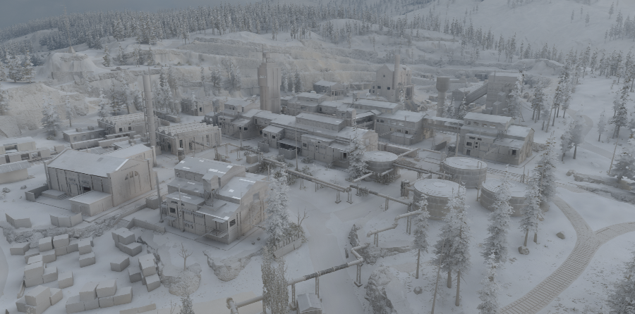
Large Maps
Ray Guiding [Ari19]
LM only
Retrace Sun (Ari)
Large Maps
Skylight (Ari)
Last LOD
Streaming (Iwanicki)
LG, LGV, LM
Lighting Consistency
Stitching Models
Merging Models
“Thin” Models
Lightmap Encoding [Sloan18]
Notes:
Large maps were a significant challenge, our levels had generally been moderately sized, so scaling things up to the huge sizes of warzone was difficult.
Ari created and refined a new system to handle large portions of the map that are outdoors, this is always resident and used as a last lighting LOD that enables us to stream the other lighting data. He plans to write this up in the near future.

Slide 15
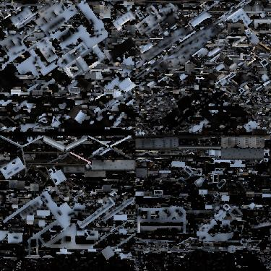
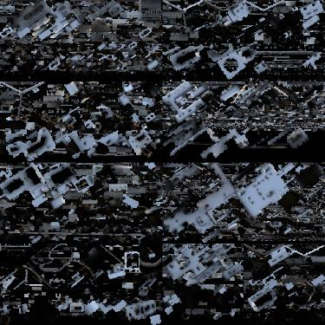
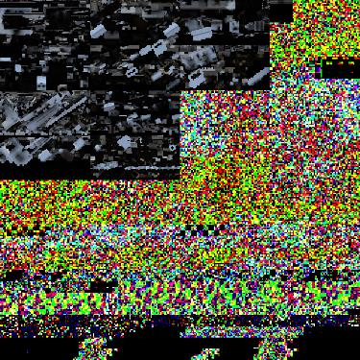
Large Maps
Ray Guiding [Ari19]
LM only
Retrace Sun (Ari)
Large Maps
Skylight (Ari)
Last LOD
Streaming (Iwanicki)
LG, LGV, LM
Lighting Consistency
Stitching Models
Merging Models
“Thin” Models
Lightmap Encoding [Sloan18]
Notes:
We had limited support for streaming lighting data in earlier games, only the lightmaps, not the light grid or static model lighting data.
Iwanicki overhauled this code in both the baking and run-time, resources are packed into a dynamic atlas for each chunk of the map, defragging as they leave to simplify resource management. The images are slices from the dynamic lightmap atlas, a single resource, with the garbage being uninitialized memory not in use. There is a similar data structure for LGV’s and LG.

Slide 16
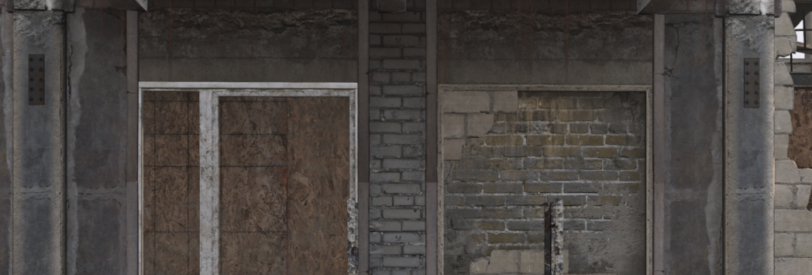
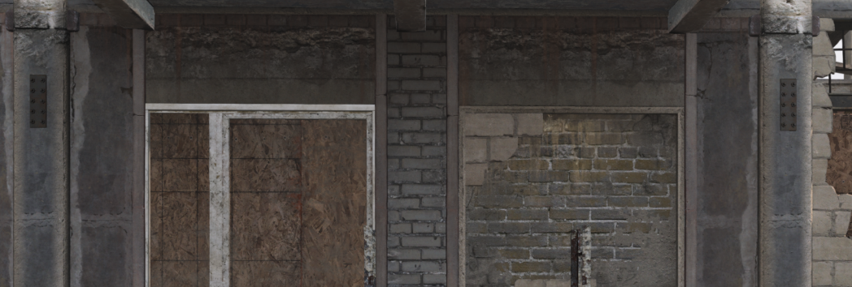
Stitching/Connecting Model Lighting
Ray Guiding [Ari19]
LM only
Retrace Sun (Ari)
Large Maps
Skylight (Ari)
Last LOD
Streaming (Iwanicki)
LG, LGV, LM
Lighting Consistency
Stitching Models
Merging Models
“Thin” Models
Lightmap Encoding [Sloan18]
No stitching
Stitching
Notes:
I described the three lighting representations we support earlier.
This can lead to visual consistency problems; we have been improving this over time and I will briefly touch on three things we did for this game.
Certain models are meant to be connected – pipes, gutters, ductwork, ventilation, molding, fences. This can be hinted when importing the assets. In the bake we build a graph of the interconnection between models that are marked this way- segments and junctions - and solve to stitch the lighting together. When building this graph, we can boost the sampling density to guarantee a gradient based on this graph – ie: force a beam to have at least two samples so we can even have a smooth lighting transition.
An early version of this was rushed in late for WW2, but it was re-written and extended for Modern Warfare. The red circle is an example shows some wooden beams on the facade of a building, where without the stitching you can see a lighting discontinuity.

Slide 17
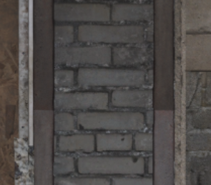
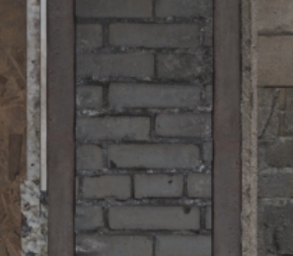
Stitching/Connecting Model Lighting
Ray Guiding [Ari19]
LM only
Retrace Sun (Ari)
Large Maps
Skylight (Ari)
Last LOD
Streaming (Iwanicki)
LG, LGV, LM
Lighting Consistency
Stitching Models
Merging Models
“Thin” Models
Lightmap Encoding [Sloan18]
No stitching
Stitching
Notes:
Here we zoom in so the seam between different models is clear, this is under an overhang, stitching the lighting fixes this.

Slide 18
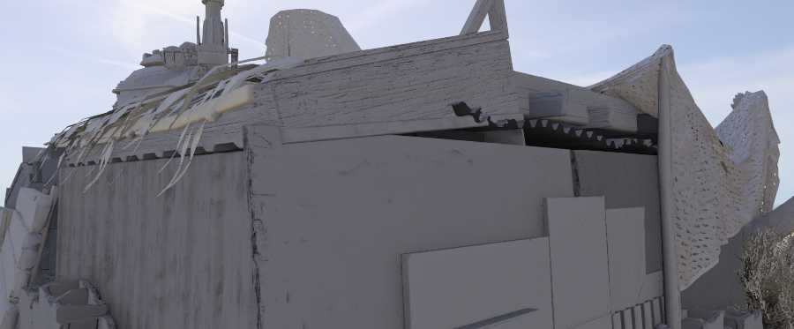
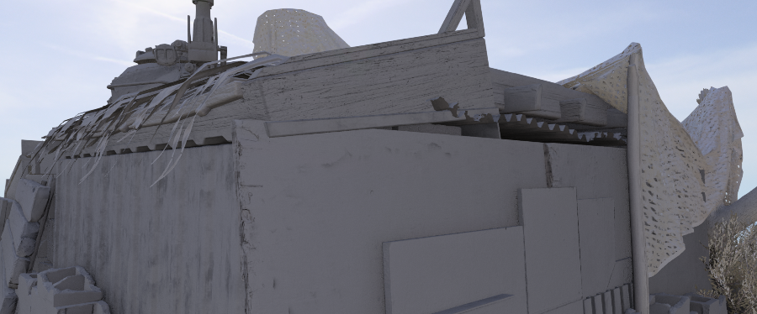
Merging Model Lighting
Ray Guiding [Ari19]
LM only
Retrace Sun (Ari)
Large Maps
Skylight (Ari)
Last LOD
Streaming (Iwanicki)
LG, LGV, LM
Lighting Consistency
Stitching Models
Merging Models
“Thin” Models
Lightmap Encoding [Sloan18]
No Merging
Merging
Notes:
We also have another system where the static model lighting data can be “shared” between models, here we have a pile of stuff, if each object gets its own probes, it can have lighting inconsistencies (see the circles in the top image.) Sharing a local volume, reduces memory and improve lightings consistency. We still validate and sample all of the models independently, but the solver fits lighting to one combined volume that explains the valid points over all the models.

Slide 19
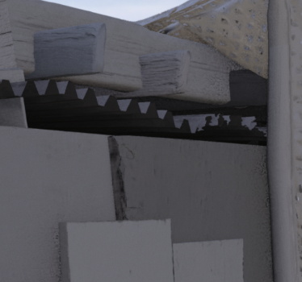
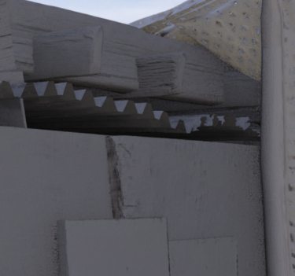
Merging Model Lighting
Ray Guiding [Ari19]
LM only
Retrace Sun (Ari)
Large Maps
Skylight (Ari)
Last LOD
Streaming (Iwanicki)
LG, LGV, LM
Lighting Consistency
Stitching Models
Merging Models
“Thin” Models
Lightmap Encoding [Sloan18]
No Merging
Merging
Notes:
Here we see the circled area in the right zoomed in. You can see some of the planks have different volumes and the lighting is less consistent in general. This isn’t used a ton, mostly if you are going to stack objects that interpenetrate each other significantly.
We use 3D textures as these mini-volumes, merging into a common volume works best for box like things, molding or duct work that goes around corners is not well represented by an OBB so they works better with stitching, we will investigate combining and automating these approaches more in the future.

Slide 20
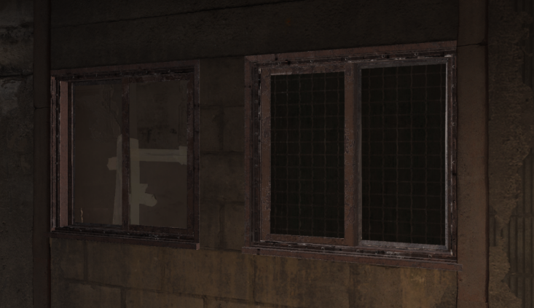
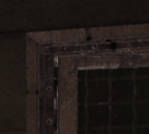
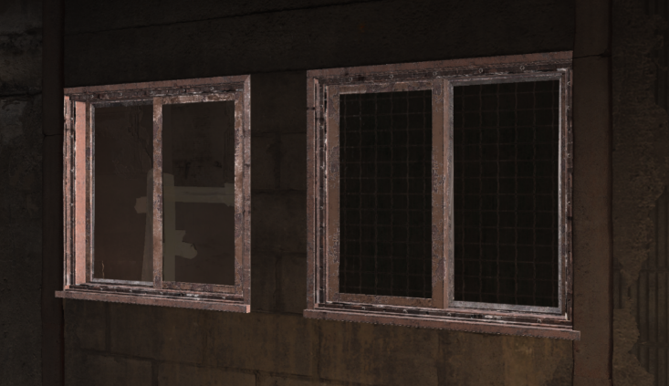
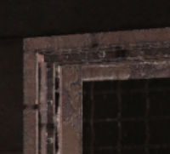
Lighting Consistency “Thin” Models
Ray Guiding [Ari19]
LM only
Retrace Sun (Ari)
Large Maps
Skylight (Ari)
Last LOD
Streaming (Iwanicki)
LG, LGV, LM
Lighting Consistency
Stitching Models
Merging Models
“Thin” Models
Lightmap Encoding [Sloan18]
Notes:
Thin models are always a challenge – in particular models that separate two very different lighting environments – a boarded up window line the one shown can split a dark interior and brightly lit exterior. This is always difficult; you can have two points that are arbitrarily close to each other with an identical normal that want very different lighting, it’s hard for any solver.
Probes are allocated per linear dimension, for thin models we force the local lighting grid to have at least two samples on the thinnest axis of the model, this captures the strong gradient fairly well.
If you don’t force two probes, the bottom window has a light leak from the bright sky outside, and vice-versa.

Slide 21
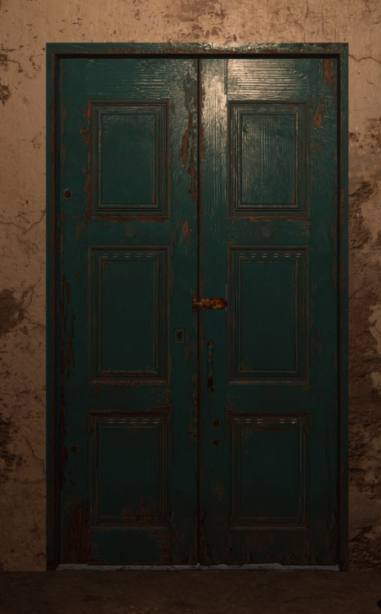
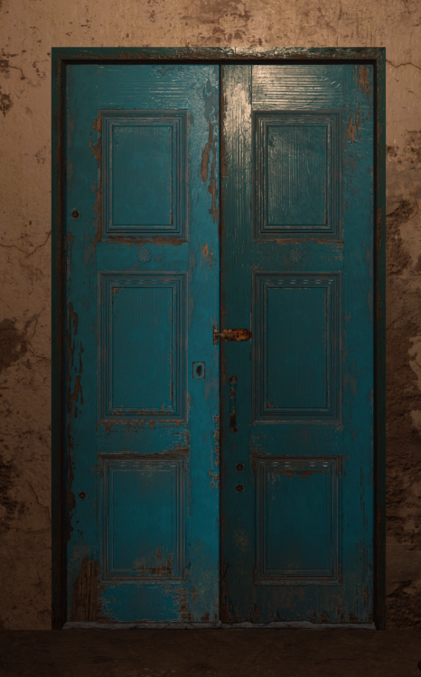
Lighting Consistency “Thin” Models
Ray Guiding [Ari19]
LM only
Retrace Sun (Ari)
Large Maps
Skylight (Ari)
Last LOD
Streaming (Iwanicki)
LG, LGV, LM
Lighting Consistency
Stitching Models
Merging Models
“Thin” Models
Lightmap Encoding [Sloan18]
Notes:
Here we have a split door – the two sides can open and close independently. The image on the right uses a single probe, and it has both un-even lighting and does not fit the rest of the room as well. This is skylight leaking through the probes.

Slide 22
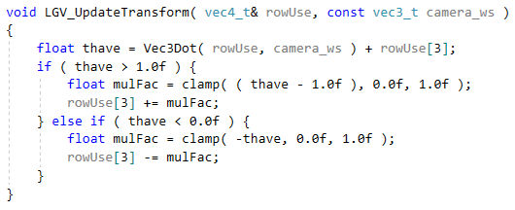
Lighting Consistency “Thin” Models
3x4 matrix from WS to [0,1] Texture Space
See what side camera is (thave)
Push bounds (w coefficient) for “thin” row
Notes:
For some models, you can’t simply boost the dimension though. Because the transition can happen anywhere inside the bounds. Ie: those boarded up window frames have this issue.
We always decompose the transform from world space to texture space into two steps. One 3x4 matrix that maps from worldspace to a unit cube, and a second transform that maps from the normalized texture coordinates into the shared 3D texture atlas.
On a single coordinate of this unit cube, a distance of 1 corresponds to the models thickness in that axis.
[click]
We can modify this 3x4 matrix to push the mapping to the unit cube, forcing the lighting to select one side or the other (remember we have at least two samples in this smallest dimension.)
This is done by just modifying the translation coefficient of the corresponding row, based on the normalized texture coordinate (thave in the code) for the camera.
I am using a door to illustrate this, but in practice you would use only use this on models you can not walk through – like the boarded-up windows I showed earlier.
You can think of this as having two 2-D lighting models, one for inside and one for outside, and the camera just decides which one to use by modifying a simple transform for that instance.

Slide 23
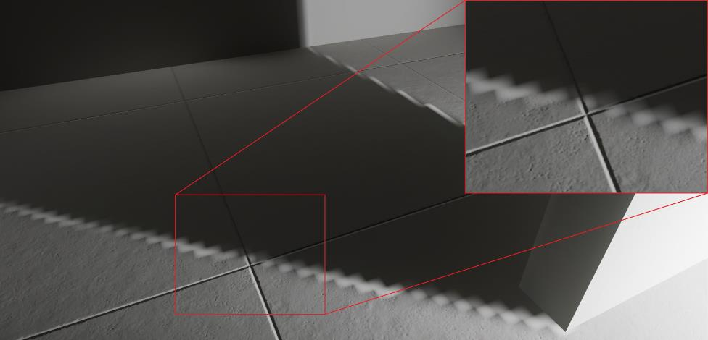
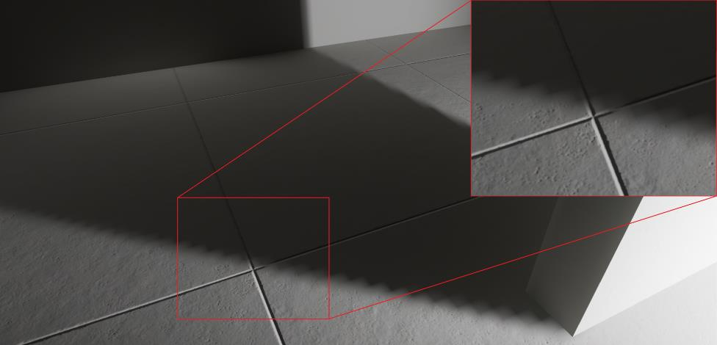
Lightmap Encoding
Ray Guiding [Ari19]
LM only
Retrace Sun (Ari)
Large Maps
Skylight (Ari)
Last LOD
Streaming (Iwanicki)
LG, LGV, LM
Lighting Consistency
Stitching Models
Merging Models
“Thin” Models
Lightmap Encoding [Sloan18]
AHD
New
Notes:
We also use a new lightmap encoding. Interestingly enough, the actual encoding was created for WW2, but not for the actual lightmap format, just compression for our dynamic GI updating system, it wasn’t until after I pushed it to the run-time encoding for Modern Warfare that I realized it solved a long standing problem with the traditional “Ambient Highlight” encoding, namely interpolation artifacts if the lighting changes significantly in space. This new encoding is used for all lightmaps now, and even when resampling light in the VS. The details are in a technical brief Ari and I wrote up, but I will present the highlights here.

Slide 24
Lightmap Encoding
(A)mbient: $C_{a}$(HDR)
(H)ilite: $C_{h}$(HDR)
(D)irection: $d$
$$C=C_{a}+dot\left(N,d\right)C_{h}$$
Ray Guiding [Ari19]
LM only
Retrace Sun (Ari)
Large Maps
Skylight (Ari)
Last LOD
Streaming (Iwanicki)
LG, LGV, LM
Lighting Consistency
Stitching Models
Merging Models
“Thin” Models
Lightmap Encoding [Sloan18]
Notes:
AHD has been used by CoD and many other games, it is simply a local lighting model that consists of an ambient and a directional light, we store the direction in tangent space, some games have used world space.
Two HDR colors (C_a and C_h in the slide) and a direction vector d are what is stored in textures.

Slide 25
Lightmap Encoding
(A)mbient: $C_{a}$(HDR)
(H)ilite: $C_{h}$(HDR)
(D)irection: $d$
$$C=C_{a}+dot\left(N,d\right)C_{h}$$
Ray Guiding [Ari19]
LM only
Retrace Sun (Ari)
Large Maps
Skylight (Ari)
Last LOD
Streaming (Iwanicki)
LG, LGV, LM
Lighting Consistency
Stitching Models
Merging Models
“Thin” Models
Lightmap Encoding [Sloan18]
Notes:
Reconstructing lighting C is trivial, and it tends to increase the contrast of normal maps so our lighters like it.

Slide 26
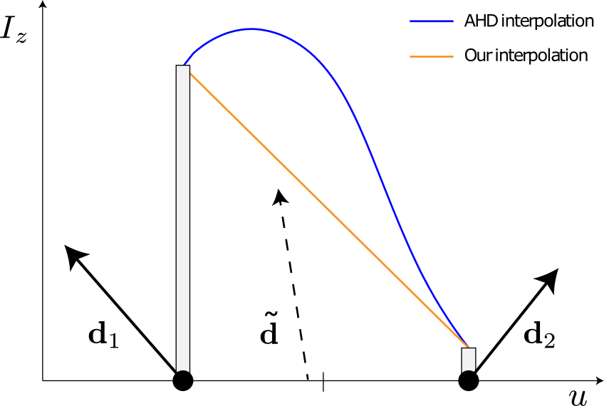
Lightmap Encoding
(A)mbient: $C_{a}$(HDR)
(H)ilite: $C_{h}$(HDR)
(D)irection: $d$
$$C=C_{a}+dot\left(N,d\right)C_{h}$$
Ray Guiding [Ari19]
LM only
Retrace Sun (Ari)
Large Maps
Skylight (Ari)
Last LOD
Streaming (Iwanicki)
LG, LGV, LM
Lighting Consistency
Stitching Models
Merging Models
“Thin” Models
Lightmap Encoding [Sloan18]
Notes:
This graph shows what was causing the artifact in the previous image, there is a big swing in the highlight direction, and you get this overshoot as you interpolate the non-linear parameters of the model causing that fringe.

Slide 27
Lightmap Encoding
(A)mbient: $C_{a}$(HDR)
(H)ilite: $C_{h}$(HDR)
(D)irection: $d$
$$C=C_{a}+dot\left(N,d\right)C_{h}$$
Ray Guiding [Ari19]
LM only
Retrace Sun (Ari)
Large Maps
Skylight (Ari)
Last LOD
Streaming (Iwanicki)
LG, LGV, LM
Lighting Consistency
Stitching Models
Merging Models
“Thin” Models
Lightmap Encoding [Sloan18]
Irradz: $I_{z}= C_{a}+{d_{z}C}_{h}$ (HDR)
Amb Ratio: $W_{a}=\frac{C_{a}}{C_{a}+d_{z}C_{d}}$ (LDR)
Direction: $d$
Notes:
Our new encoding has a single HDR color – I_z the irradiance in local Z which is just an old school lightmap, the same direction as before and an LDR value that we call the ambient ratio.
This ambient ratio can either be RGB or luminance, we found that luminance tended to be fine so that is what we shipped in the game. This trades an HDR color for a single LDR number and fixes the interpolation artifact.

Slide 28
Lightmap Encoding
(A)mbient: $C_{a}$(HDR)
(H)ilite: $C_{h}$(HDR)
(D)irection: $d$
$$C=C_{a}+dot\left(N,d\right)C_{h}$$
Ray Guiding [Ari19]
LM only
Retrace Sun (Ari)
Large Maps
Skylight (Ari)
Last LOD
Streaming (Iwanicki)
LG, LGV, LM
Lighting Consistency
Stitching Models
Merging Models
“Thin” Models
Lightmap Encoding [Sloan18]
Irradz: $I_{z}= C_{a}+{d_{z}C}_{h}$ (HDR)
Amb Ratio: $W_{a}=\frac{C_{a}}{C_{a}+d_{z}C_{d}}$ (LDR)
Direction: $d$
$$C_{a}=I_{z}W_{a}$$
$$C_{d}= \frac{I_{z}(1−W_{a})}{d_{z}}$$
Notes:
The AHD colors can trivially be reconstructed using the highlighted math. See the write up for more details.

Slide 29
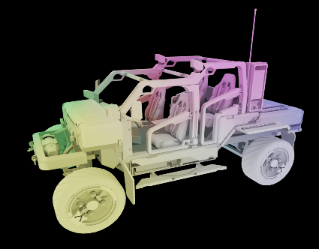
Static Model Lighting Evolution
[Iwanicki17a] Simplicial complex for the per-object lighting, with self-vis and SH.
VS does multiply fits AHD.
Vertex baking (AHD) optional.
[Chan18] moved to Ambient Dice [Iwanicki17b], and 3D textures.
Done in PS, Atlas rebuilt every frame.
Killed vertex baking.
Started in PS, but largely moved to VS for performance reasons.
PS uses new LM encoding, save’s 1/3rd VS instructions vs. AHD.
Non-linear encoding cut memory in half.
Linear SH for double-sided and transmission.
Decoupled from geometry (merging).
Static has fixed atlas, dynamics per-frame.
Notes:
Things have evolved since our 2017 talk. In that game the static model lighting was tetrahedrons with SH. The barycentric coordinates and the probe indices were stored in the vertices (like matrix skinning) per object so you don’t have to search tets, this did make it so that the lighting had a hard coupling to the geometry . The starting address for each instance was stored and only the lighting probes were instanced.
In the vertex shader this was multiplied with self-vis and projected into the AHD basis. We also still supported vertex baking in this game.

Slide 30
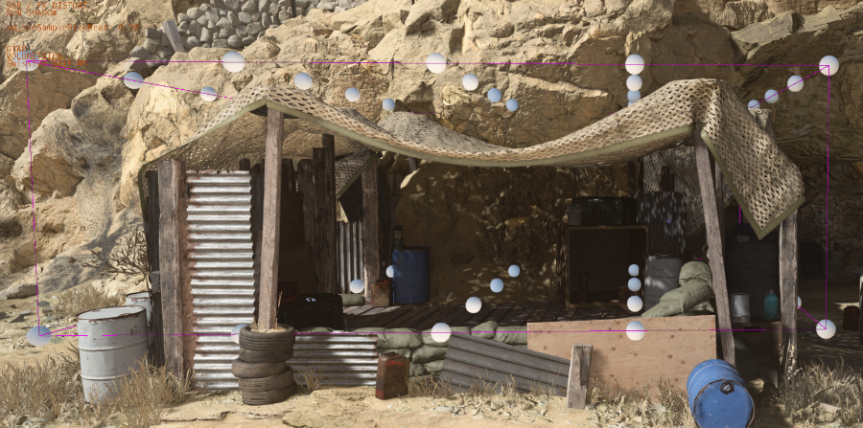
Static Model Lighting Evolution
[Iwanicki17a] Simplicial complex for the per-object lighting, with self-vis and SH.
VS does multiply fits AHD.
Vertex baking (AHD) optional.
[Chan18] moved to Ambient Dice [Iwanicki17b], and 3D textures.
Done in PS, Atlas rebuilt every frame.
Killed vertex baking.
Started in PS, but largely moved to VS for performance reasons.
PS uses new LM encoding, save’s 1/3rd VS instructions vs. AHD.
Non-linear encoding cut memory in half.
Linear SH for double-sided and transmission.
Decoupled from geometry (merging).
Static has fixed atlas, dynamics per-frame.
Notes:
In WW2, we switched the lighting to use Ambient Dice, and more importantly we moved from a simplicial grid to a 3D texture atlas. This decoupled the lighting from the geometry and allowed us to move lighting evaluating to the pixel shaders.
A texture atlas was repacked every frame for both the static and dynamic models and the self-vis multiply was approximated.
We also killed vertex baking as an option, it was heavy (AHD per vertex) and we did not want to support it when doing dynamic GI updates that I will talk about later.

Slide 31
Static Model Lighting Evolution
[Iwanicki17a] Simplicial complex for the per-object lighting, with self-vis and SH.
VS does multiply fits AHD.
Vertex baking (AHD) optional.
[Chan18] moved to Ambient Dice [Iwanicki17b], and 3D textures.
Done in PS, Atlas rebuilt every frame.
Killed vertex baking.
Started in PS, but largely moved to VS for performance reasons.
PS uses new LM encoding, save’s 1/3rd VS instructions vs. AHD.
Non-linear encoding cut memory in half.
Linear SH for double-sided and transmission.
Decoupled from geometry (merging).
Static has fixed atlas, dynamics per-frame.
Notes:
For MW we moved the lighting back to the VS for performance reasons. We also made the vertex encoding the lightmap format I described earlier. This reduced our vertex shader instruction counts by around 1/3rd, but had a minimal performance improvement – the GPU dispatch pipeline was heavily optimized for this game so we rarely are VS limited.
We use a fixed atlas for the static models (there are a lot of them), and re-pack only the dynamic objects every frame.
We also moved back to SH, using a non-linear encoding cutting the memory in half, and for transmissive and double-sided materials use linear SH with a new reconstruction algorithm. I will describe both of these later.
We can see the LGV for a model – the tarp in this example – and the bounds along with the probe values (solved from lighting values on the tarp itself, so just sampled from the top surface which is why the probes are all fairly bright.)

Slide 32
Spherical Harmonic
Insights
Notes:
I am now going to briefly talk about some of the SH related topics I referred to earlier.

Slide 33
SH Encoding (TLDR)
Store DC in some FP format (11f11f10f, FP16, BC6h, etc.)
When divided by DC coefficients in band L have an upper bound $\sqrt{2L+1}$ so (linear, quadratic) is $(\sqrt{3},\sqrt{5})$
If convolved with normalized cosine is $\left(\frac{2\sqrt{3}}{3},\frac{\sqrt{5}}{4}\right)$
Divide higher order terms by DC, store as LDR (other people do this as well)
Multiply by reciprocal of upper bound $(\frac{1}{\sqrt{3}},\frac{1}{\sqrt{5}})$ radiance, $\left(\frac{3}{2\sqrt{3}},\frac{4}{\sqrt{5}}\right)$ convolved, this brings to [-1,1]
Use SNORM, or map to [0,1] preserving 0 (divide by 127, add 127)
Decode is simple, map to [-1,1], multiply by upper bound and DC
If stored in buffers, 32 with 4 bytes of padding, vs. 64 with 10 bytes of padding for half’s.
Notes:
We store DC in an FP format, we use 11f11f10f, but other formats are possible. The higher bands are divided by DC and stored in LDR textures. This I think is fairly common, I know from personal communication that at least Epic does this for example.
With reasonable assumptions it turns out there is an analytic upper bound on these LDR values. The largest a coefficient can be in band L is sqrt(2L + 1). So sqrt(3) for linear SH and sqrt(5) for the quadratics – which is the most we generally store.
To encode an SH, you simply scale by the reciprocal of the upper bound, and either use a SNORM 8 bit format, or map to [0,1] carefully so that zero is preserved.

Slide 34
SH Encoding (TLDR)
Store DC in some FP format (11f11f10f, FP16, BC6h, etc.)
When divided by DC coefficients in band L have an upper bound $\sqrt{2L+1}$ so (linear, quadratic) is $(\sqrt{3},\sqrt{5})$
If convolved with normalized cosine is $\left(\frac{2\sqrt{3}}{3},\frac{\sqrt{5}}{4}\right)$
Divide higher order terms by DC, store as LDR (other people do this as well)
Multiply by reciprocal of upper bound $(\frac{1}{\sqrt{3}},\frac{1}{\sqrt{5}})$ radiance, $\left(\frac{3}{2\sqrt{3}},\frac{4}{\sqrt{5}}\right)$ convolved, this brings to [-1,1]
Use SNORM, or map to [0,1] preserving 0 (divide by 127, add 127)
Decode is simple, map to [-1,1], multiply by upper bound and DC
If stored in buffers, 32 with 4 bytes of padding, vs. 64 with 10 bytes of padding for half’s.
Notes:
Decoding is just multiplication by the upper bound times DC.
We often store SH in buffers, for example the LG, this works out to 32 bytes with 4 bytes of padding or other data vs. the 64 bytes we used before storing as half’s. We also directly encode this in textures.

Slide 35
Warning!
There is a bunch of math on the next slides
feel free to take a bio break if that’s not your thing.
Notes:
What are the reasonable assumptions and where does this upper bound come from? Are there problems interpolation in this space? I am going to spend some time trying to give some insights into this that I hope people find useful.
This next block of slides has a bunch of math, that is really just trying to build some intuition. If that’s not your bag, take a bio bake or continue looking at your phone.

Slide 36
Spherical Harmonics
$$y_{00}\left(s\right)$$
L is band, m is function in band (-L..L)
$$y_{lm}\left(s\right)$$
$$L=0$$
$$L=1$$
$$y_{1−1}\left(s\right)$$
$$y_{10}\left(s\right)$$
$$y_{11}\left(s\right)$$
$$L=2$$
$$y_{2−2}\left(s\right)$$
$$y_{2−1}\left(s\right)$$
$$y_{20}\left(s\right)$$
$$y_{21}\left(s\right)$$
$$y_{22}\left(s\right)$$
Notes:
We are going to talk about SH, they are often drawn with these lobes, there are 2L+1 functions in a band, L is the band and is the first index m is the basis function in a band and is the second index

Slide 37
Zonal Harmonics
$$\frac{1}{2\sqrt{π}}$$
$$\frac{−\sqrt{3}}{2\sqrt{π}}y$$
$$\frac{\sqrt{3}}{2\sqrt{π}}z$$
$$\frac{−\sqrt{3}}{2\sqrt{π}}x$$
$$\frac{\sqrt{15}}{2\sqrt{π}}xy$$
$$\frac{−\sqrt{15}}{2\sqrt{π}}yz$$
$$\frac{\sqrt{5}}{4\sqrt{π}}\left(3z^{2}−1\right)$$
$$\frac{−\sqrt{15}}{2\sqrt{π}}xz$$
$$\frac{\sqrt{15}}{4\sqrt{π}}\left(x^{2}−y^{2}\right)$$
Notes:
We’re going to make use of a subset of the spherical harmonics called “zonal harmonics”, shown here in the center column.
Zonal harmonics have only 1 basis function per band, and represent polynomials in Z.
Any function that has circular symmetry around the Z axis when projected into SH only has non-zero coefficients corresponding to the zonal harmonics.
We are going to spend most of the time looking at Delta functions, which are always ZH, and simply the sum of the ZH basis functions in the canonical frame.

Slide 38
SH As Scalar Function on Sphere
$$L=2$$
$$L=1$$
$$L=0$$
Notes:
Another visualization technique, that we use in most of this talk, is to show SH as a scalar function on a sphere – coloring based on the sign, red for positive blue for negative.
We also are going to flip the pyramid, so DC on the bottom, and show each one as a pair of hemispheres (upper hemisphere on the bottom).
We are going to talk about delta functions a lot, for SH it is simple, it is just the coefficient vector from evaluating each basis function at the same spot on the sphere.

Slide 39
SH Projection
Projection:
$${\tilde{f}}_{lm}= \int{Y_{lm}\left(ω\right)f\left(ω\right)dω}$$
Reconstruction:
$$\tilde{f}\left(s\right)=\sum_{l}{\sum_{m}{{\tilde{f}}_{lm}Y_{lm}(s)}}$$
Notes:
Spherical Harmonics over the sphere are an orthonormal basis, so projection is quite simple.
You just integrate the function you want to project against each basis function, generating a vector of coefficients.

Slide 40
SH Projection
Projection:
$${\tilde{f}}_{lm}= \int{Y_{lm}\left(ω\right)f\left(ω\right)dω}$$
Reconstruction:
$$\tilde{f}\left(s\right)=\sum_{l}{\sum_{m}{{\tilde{f}}_{lm}Y_{lm}(s)}}$$
Notes:
Reconstruction for a direction s is then just evaluate the SH basis function in that direction, and dot them with the vector of coefficients.

Slide 41
SH Projection
Projection:
$${\tilde{f}}_{lm}= \int{Y_{lm}\left(ω\right)f\left(ω\right)dω}$$
Reconstruction:
$$\tilde{f}\left(s\right)=\sum_{l}{\sum_{m}{{\tilde{f}}_{lm}Y_{lm}(s)}}$$
Delta Function:
$${\tilde{f}}_{lm}=\int{Y_{lm}\left(ω\right)δ\left(ω_{i}\right)dω}=Y_{lm}(ω_{i})$$
Notes:
The projection of a delta function into SH amounts to simply sampling the SH in the direction of the delta function. Here we see that with the green dots in each of the 9 quadratic SH functions.

Slide 42
Projection of a Non-Negative SH
Most (but not all!) signals are non-negative, ie: radiance
Transfer functions can be negative, response to basis functions with negative values – steerable approximations for sun, SH for sky, PRT, etc.
Monte-Carlo integration for SH projection weighted sum of SH Projection of delta functions
${\tilde{f}}_{lm}=\sum_{i}{Y_{lm}\left(x_{i}\right)\frac{f(x_{i})}{n p\left(x_{i}\right)}}$
Riemann integral is just a weighted sum of delta functions
Projection into SH can be understood just looking at properties of delta functions
Notes:
Most signals we care about are non-negative – lighting, visibility, There are exceptions – PRT, some steerable illumination basis that can have negative values.

Slide 43
Projection of a Non-Negative SH
Most (but not all!) signals are non-negative, ie: radiance
Transfer functions can be negative, response to basis functions with negative values – steerable approximations for sun, SH for sky, PRT, etc.
Monte-Carlo integration for SH projection weighted sum of SH Projection of delta functions
${\tilde{f}}_{lm}=\sum_{i}{Y_{lm}\left(x_{i}\right)\frac{f(x_{i})}{n p\left(x_{i}\right)}}$
Riemann integral is just a weighted sum of delta functions
Projection into SH can be understood just looking at properties of delta functions
Notes:
Monte-carlo integration of projection into a function space becomes a sum of delta functions scaled by the intensity of the function we are projecting. So understanding the SH projections of delta functions, and their sums is important.
Here I show importance sampling of some function projected into SH (ie: gathering in a PT, etc.), the highlighted box is just the projection of a delta function, so in most SH computations we are going to be summing scaled delta functions.

Slide 44
Projection of a Non-Negative SH
Most (but not all!) signals are non-negative, ie: radiance
Transfer functions can be negative, response to basis functions with negative values – steerable approximations for sun, SH for sky, PRT, etc.
Monte-Carlo integration for SH projection weighted sum of SH Projection of delta functions
${\tilde{f}}_{lm}=\sum_{i}{Y_{lm}\left(x_{i}\right)\frac{f(x_{i})}{n p\left(x_{i}\right)}}$
Riemann integral is just a weighted sum of delta functions
Projection into SH can be understood just looking at properties of delta functions
Notes:
In particular, any non-negative function is projected into SH by essentially summing delta functions – Riemann integrals can be looked at that way.
So we are going to look closely at properties of delta functions to understand the bounds I already showed.

Slide 45
SH Delta Function
Notes:
I am going to show you some video from a shadertoy.
The two large circles are a visualization of the projection of a delta function in SH. The top circle is –Z, the bottom circle is +Z, blue is negative, red is positive.

Slide 46
SH Delta Function
$$\sum_{m}{{\tilde{f}}_{2m}^{2}}$$
$$\sum_{m}{{\tilde{f}}_{1m}^{2}}$$
$${\tilde{f}}_{00}^{2}$$
Notes:
This first column to the right shows the sum of the squares per-band – the blue box on the top is the quadratics, the green box is the linear and red is DC.

Slide 47
SH Delta Function
$${\tilde{f}}_{20}^{2}$$
$${\tilde{f}}_{10}^{2}$$
$${\tilde{f}}_{00}^{2}$$
Notes:
The far right column is showing the squares of individual basis functions in a band. I just have the ZH functions shown since they are large enough for this orientation.
So the individual components of the 5 quadratics, followed by the 3 linear and DC (the red bars will always be the same height.)

Slide 48
SH Delta Function
Notes:
When the video plays, you can see that the sum of the squares in a band is constant for any orientation of the delta function.
This comes from the rotation invariance of the spherical harmonics. Delta functions are steerable, in that the reconstructed lobes look the same for any direction, they are just rotated.

Slide 49
Adding Two Delta Functions
-Z
+Z
-Z
+Z
Notes:
Now we are going to show a tweak to the shader toy, where instead of having a single delta function, we are going to show the sum of two delta functions. They are visualized on the left of this image, and are pretty much the same.
[click]
The purple box represents one of the probes, bottom circle is +Z, top circle is –Z
[click]
the second delta function is below, they are identical in this example.

Slide 50
Adding Two Delta Functions
Notes:
Now we are going to change one of the functions, notice how the squared norms and both the bands and the individual basis functions grow and shrink.
This is from either constructive or destructive interference.
The critical point here, is that we are adding two delta functions multiplied by positive values, that is why DC doesn’t ever change. If you had a negative value, DC would decrease, and can even go to zero (or negative) while the other basis functions are non-zero.
If this happens, you might need more precision to represent the ratio of a band over DC.

Slide 51
Constructive Interference
Notes:
Here is the image before, the delta functions are close to identical, so all the energy is in a single function per band.

Slide 52
Mixed Interference
Notes:
Now the delta functions are on the same hemisphere, but fairly far apart – the linear and quadratic terms both shrink quite a bit.

Slide 53
Destructive Interference
Notes:
Now they are almost anti-podal, the linear function has almost maximal destructive interference because it is an odd function, actual anti-podal points have zero linear SH projection.
One comment on this, numerically summing the anti-podal points together helps with the odd degree SH, reducing cancellation error.
So we are adding waves, and they either build increasing the magnitude of a coefficient, or they subtract from each other decreasing a coefficient or entire band.

Slide 54
What is the Bound?
L2 norm of each band divided by DC is a constant: $∑{\left(\frac{Y_{lm\left(z\right)}}{Y_{00}}\right)}^{2}=(2L+1)$
This is from structure of rotation matrix
Determinant 1, eigenvalues all 1
Non-negative functions have bound
Negatives mean DC can go to zero, destructive interference for DC
Max coefficient over DC: $\sqrt{2L+1}$
Notes:
delta functions have constant per-band L2 norm, and positive functions make DC only grow.
This means that when you divide by DC, there is an upper bound on what any coefficient could possibly be – which is adding waves that maximally are constructive. The sum of the squares in a band turns out to be (2L+1)
Fortunately, this is easy to reason about – for entire bands, let alone individual functions – by simply analyzing the SH values of a delta function. Take the equations from the ZH slide, and divide them by the equation for DC, evaluate them with theta = 0 and you get these values.
The reason we can look at just the canonical frame is that the delta function doesn’t change under rotation. This is because SH rotation matrices are independent per-band, and each band has determinant 1 and all eigenvalues that are 1. So no matter how you rotate, the length of the coefficient vector in a band stays the same – this is what we showed in the earlier animation.
The ZH in the canonical pose (oriented with Z) have just one non-zero basis function per-band. Since the L2 norm of the coefficient vector is preserved over rotations, the square root of the per-band bound is the upper bound for this value, and also an upper bound for any single basis function.

Slide 55
What Else Can we do with this?
Oracle – is this SH value possibly the projection of a non-negative function?
Regularization during least squares solves (increase regularization if you have a crazy answer)
LG and LGV use least squares solves
Deringer assumes this bound – most aggressive convolution constructed assuming strictly positive function…
Spatial inpainting of SH with gradient extrapolation – force into bounds of real signals
Encoding originally done just for Dynamic Light Sets, encoding with $\sqrt{\left|x\right|}$ and decoding with $x^{2}$ reduced L1 error by 50% on a level I tested, but you don’t want to interpolate that.
Notes:
This bound can also be used for things besides quantization.
When solving for SH coefficients, use an oracle to determine if an SH could have been created from a positive input signal. If it fails, you crank up the regularization. Here we use the stronger per-band (instead of per-coefficient) bound. We do this when solving for LGVs, and spatially inpainting with gradient extrapolation.

Slide 56
What Else Can we do with this?
Oracle – is this SH value possibly the projection of a non-negative function?
Regularization during least squares solves (increase regularization if you have a crazy answer)
LG and LGV use least squares solves
Deringer assumes this bound – most aggressive convolution constructed assuming strictly positive function…
Spatial inpainting of SH with gradient extrapolation – force into bounds of real signals
Encoding originally done just for Dynamic Light Sets, encoding with $\sqrt{\left|x\right|}$ and decoding with $x^{2}$ reduced L1 error by 50% on a level I tested, but you don’t want to interpolate that.
Notes:
I stumbled into this encoding working on WW2, where we used it to store probes that were unpacked in compute shaders. In that case, another non-linearity that is quite simple – just square root on encode, square on decode – allocated more values close to zero, this reduced the L1 reconstruction error by 50% on one of our night levels doing tests. You don’t want to interpolate using that non-linear encoding though, but we have places (LG and dynamic light sets) where we never directly interpolate so use that format instead.

Slide 57
Non-Linear Interpolation
DC is always correct, since it is linear
When DC is the same, it is exact (quite common for LGV’s…)
P0 = P1 * s (scaled value) is also exact
Notes:
So one issue with this is we now have a non-linear model, but I consider it weakly non-linear.
DC is the same as if everything was FP
The other basis functions will be exactly correct if DC is identical when interpolating between two values.
If two SH are scalar multiples of each other, the result is also identical with linear interpolation. We see the result on the right, these graphs have “t” from [0,1] on X axis, Y axis is the interpolated basis function – both the linear result (blue) and the reconstructed result using our encoding (red).
Reconstruction means interpolate basis function divided by DC, interpolate DC and then take the product.

Slide 58
Non-Linear Interpolation
DC is always correct, since it is linear
When DC is the same, it is exact (quite common for LGV’s…)
P0 = P1 * s (scaled value) is also exact
Notes:
If the values are different, the interpolated result can under or over-shoot, but it is still exact at the texel centers. This is kind of like the interpolation problem for the lightmap encoding, but we have more data that actually is linear (DC).

Slide 59
Non-Linear Interpolation
DC is always correct, since it is linear
When DC is the same, it is exact (quite common for LGV’s…)
What if you interpolate a value with a zero vector?
Lerped DC: $dc ∗ t+0 ∗(1−t)$
Lerped bf: $\frac{bf}{dc} ∗ t+0 ∗(1−t)$
Decoded: $(\frac{bf}{dc} ∗ t ) ∗ ( dc ∗ t )$ = $bf ∗t^{2}$
Off by a factor of t, in the worst case, can you do better?
In zero voxels, store average bf/dc of neighbors for higher order terms (leave dc zero)
Lerped bf: $\frac{bf}{dc}∗t+\frac{bf}{dc}∗\left(1−t\right)=\frac{bf}{dc}$
“dual regularization”?, modify original values so that interpolation doesn’t have as much error, I have done this just at the dual voxel centers, needs to be investigated more
Notes:
What if we interpolated with a zero SH?
In that case lerped DC is dc * t, and the lerped bf is bf/dc * t
When you reconstruct in the shaders (multiply by interpolated dc) you get bf * t^2, so it’s interpolating with a quadratic function in this worst case. Is there anything we can do to improve this?

Slide 60
Non-Linear Interpolation
DC is always correct, since it is linear
When DC is the same, it is exact (quite common for LGV’s…)
What if you interpolate a value with a zero vector?
Lerped DC: $dc ∗ t+0 ∗(1−t)$
Lerped bf: $\frac{bf}{dc} ∗ t+0 ∗(1−t)$
Decoded: $(\frac{bf}{dc} ∗ t ) ∗ ( dc ∗ t )$ = $bf ∗t^{2}$
So off by a factor of t, in the worst case, can you do better?
In zero voxels, store average bf/dc
Lerped bf/dc: $\frac{bf}{dc}∗t+\frac{bf}{dc}∗\left(1−t\right)=\frac{bf}{dc}$
Notes:
For the zero case, it turns out there is something you can do. If you store the average bf/dc of the neighbors, but leave the DC zero (it’s linear and needs to be left alone) you will still reconstruct a zero vector at the zero voxel.
But if you look at 1D interpolation it removes the extra factor of t.
I have looked at this since shipping, in practice in Modern Warfare the lighting didn’t change enough over the low res LGV’s for this to make a big difference.

Slide 61
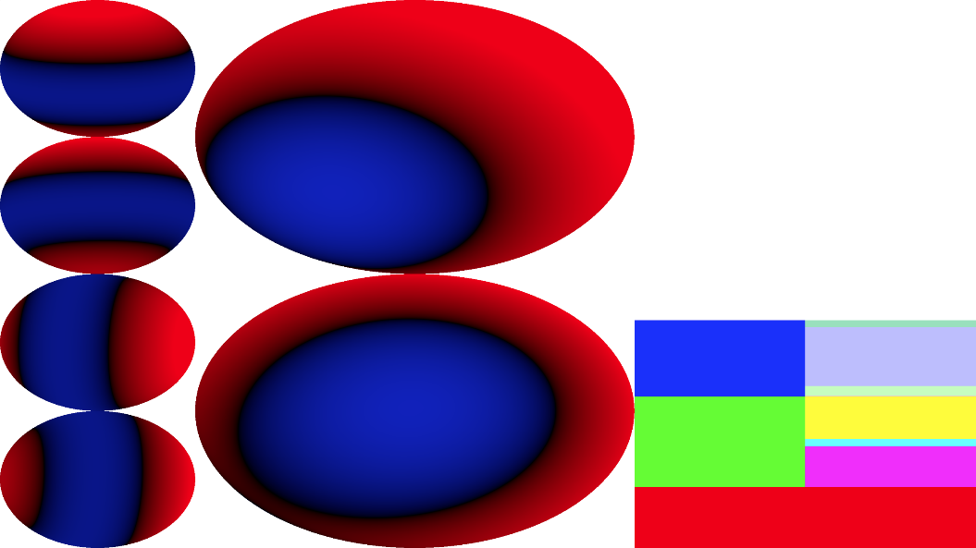
Another Non-Linear Way to Interpolate SH
Functions spaces that are linear are great!
Lights can be added independently
Scaling an SH probe just scales intensity of light
MC Integration
When are they not?
Smoothing visibility functions?
Hemisphere North + Hemisphere East
Linear is faded vis in both directions
Maybe we want full hemisphere at 45 Degrees?
What if we are mixing distributions?
Notes:
Linear function spaces, like SH are great, they are known to be well behaved when you interpolate them.
If you want to sum two lighting environments, you can simply add the coefficients together, same thing with making something brighter – just scale it.
What I am going to talk about here is for other signals – lets imagine that the two lobes we are summing on the picture on the right are visibility functions – a lobe to the north and a lobe to the east. When you add them, you get a very broad, blurry lobe to the north east. You can see there is a fair amount of destructive interference with the higher order functions.

Slide 62
Another Non-Linear Way to Interpolate SH
Functions spaces that are linear are great!
Lights can be added independently
Scaling an SH probe just scales intensity of light
MC Integration
When are they not?
Smoothing visibility functions?
Hemisphere North + Hemisphere East
Linear is faded vis in both directions
Maybe we want full hemisphere at 45 Degrees?
What if we are mixing distributions?
Notes:
Are there cases where you might want to do something else?
What if we are mixing distributions? Ie: when blending BRDF lobes, you don’t want to always cross-fade between them, but build a new distribution that isn’t just the linear blend, same for histograms. Optimal Transport algorithms look at these types of problems.
I sometimes uses a non-liner filter when smoothing visibility functions that I will describe now.

Slide 63
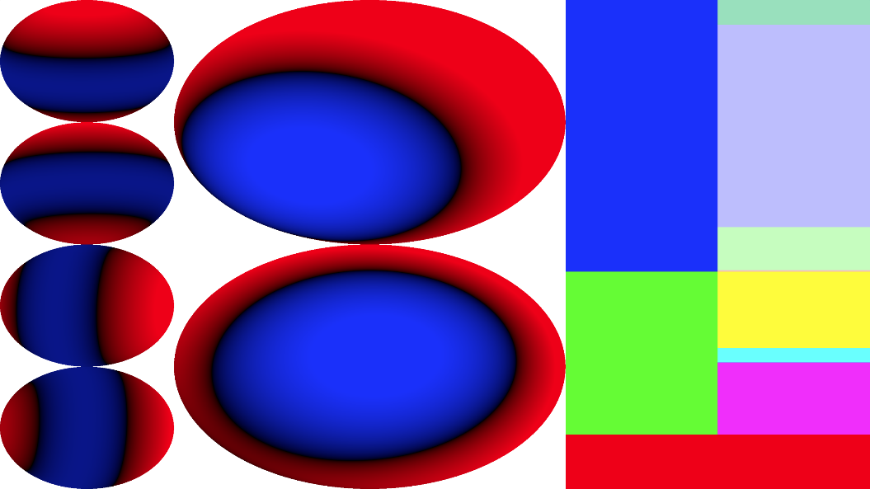
Augment SH with per-Band L2 Norm
SH3 now has 2 extra numbers, $\sqrt{∑l_{m}^{2}}$ length of coefficients in a band, one for linear, one for quadratic
Interpolate augmented vector linearly
Scale each band so the length is the same as the interpolation of the augmented length
Think of each band as a point on a sphere in $ℝ^{2L+1}$ with a radius $\sqrt{∑l_{m}^{2}}$
Notes:
One trick that can be useful, is to augment the SH with the length of each band – just the square root of the sum of the squares. A quadratic SH would have 2 extra numbers in this case, the length of the linear SH and the length of the quadratic. The square root of the green and blue per-band bars from the visualizations I was showing.
These extra numbers are just the square root of the green and blue bars (for each function before adding them, not after).
You simply interpolate this augmented vector linearly, then you rescale each band so that it’s length equals the interpolated length.
In our north and east distribution, we get this result – which is pretty close to the scaled delta function in that angle, which is probably what we would be after.

Slide 64
Augment SH with per-Band L2 Norm
SH3 now has 2 extra numbers, $\sqrt{∑l_{m}^{2}}$ length of coefficients in a band, one for linear, one for quadratic
Interpolate augmented vector linearly
Scale each band so the length is the same as the interpolation of the augmented length
Think of each band as a point on a sphere in $ℝ^{2L+1}$ with a radius $\sqrt{∑l_{m}^{2}}$
If the two points are on the same sphere
Notes:
It can be handy to think of each band as a point on a sphere in R^(2L+1), with a radius that is the length of that sub-vector. So R3 for linear SH, R5 for quadratic SH.
If the two points are on the same sphere (so same L2 norm of the band) but different locations on the sphere, linear interpolation cuts across using the chord, where the augmented interpolation pushes things back to the arc. It makes the blue line map to the red line, by scaling around the origin of the sphere.
This is the same as renormalizing a normal or quaternion after interpolating it, except the radius is not necessarily 1.

Slide 65
Augment SH with per-Band L2 Norm
SH3 now has 2 extra numbers, $\sqrt{∑l_{m}^{2}}$ length of coefficients in a band, one for linear, one for quadratic
Interpolate augmented vector linearly
Scale each band so the length is the same as the interpolation of the augmented length
Think of each band as a point on a sphere in $ℝ^{2L+1}$ with a radius $\sqrt{∑l_{m}^{2}}$
What about different spheres?
Notes:
What if the points are on different spheres?
In that case linear interpolation can potentially cut under the smaller, where augmented interpolation would take a path that is a curve going between the two radii. Now the blue points are scaled to a sphere whose radius smoothly changes between the two spheres, which is what the red curve is trying to visualize.

Slide 66
Augmented Non-Linear Interpolation Caveats
Most of the time you want linear interpolation
I use it when solving for visibility, and have started looking at it with volumetric inpainting
Trees were getting “too dark”
It can explode (maximal destructive interference)
Notes:
So I have only used this in two places:
When computing self-visibility, we found for things like trees the interpolated SH Vis could get too dark, and this helped somewhat.
I have also investigated using it for volumetric inpainting, but am not as confident in that in general.
I don’t think this is something you would generally want to do in shaders, but more in off-line tools. I have found it handy and I think it’s a useful way to think about SH in general.
If you are storing distributions in SH, I think this is a reasonable way to combine them (ie: BRDF’s).
This is definitely not something you would ever want to do when computing integrals – you would get non-sensical results.

Slide 67
Linear SH Revisited
Alternate Reconstruction
Notes:
Now I am going to cover my last SH topic, another way to reconstruct irradiance from linear SH.

Slide 68
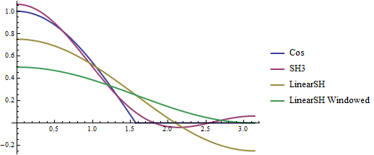
SH Reconstruction Directional Light
Linear SH are not that great
Notes:
So linear SH are nice in that they don’t need a lot of numbers, they have 4 vs. 9 basis functions for quadratic SH. But they really struggle when trying to represent lighting.
Here we see angular response to a directional light as a function of theta [0,Pi], the X axis of this graph. The blue curve is the clamped cosine, it falls to zero at Pi/2 and behaves like one would think.
The purple curve is quadratic SH, it overshoots a bit at incidence, has a bit of wrap and both a negative and a positive “ring”.
The yellow curve is linear SH. It is really far at incidence and goes very negative on the back of the sphere. If you window it to be non-negative you get the green curve, and it wraps like crazy.

Slide 69
Geomerics Reconstruction
Linear SH isn’t great, let’s do a couple of things:
Preserve energy (DC of SH projection)
Approximate a directional light
Strictly non-negative
Linear SH always a SRBF, ratio of linear to DC to lerp between a directional light (ratio 1 geo, $\sqrt{3/\left(4π\right)}$ SH) and a constant function (ratio 0 in both…), SRBF kernel is $(\frac{1}{2}{\left(dot\left(N,L\right)+1\right)}^{p})$
https://grahamhazel.com/blog/2017/12/22/converting-sh-radiance-to-irradiance/
https://grahamhazel.com/blog/2017/12/18/alternative-definition-of-spherical-harmonics-for-lighting/
Notes:
Probably the most common solution when using linear SH is to use the reconstruction algorithm from Geomerics. Graham Hazel details this in some papers and a couple of very nice blog posts. I won’t go over the details here, but it has three nice properties:
It always preserves DC, so the energy is preserved.
It uses the ratio of linear SH to DC (vector irradiance to DC in the writeup, but it’s the same up to a constant scale) to essentially lerp between something that approximates a directional light and an ambient light.
The resulting function is strictly non-negative.
Linear SH functions are always Spherical Radial Basis Functions (SRBF’s), where the “optimal linear” direction from the literature is the axis of the function, and the SRBF is simply a cosine.
The Geomerics functions are also SRBF’s, where the kernel uses a carefully designed non-integer power based on the ratio of linear to DC.
This code snippet is how to convert linear SH (radiance or irradiance) to the geomerics coefficients.

Slide 70
Geomerics Reconstruction
Linear SH isn’t great, let’s do a couple of things:
Preserve energy (DC of SH projection)
Approximate a directional light
Strictly non-negative
Linear SH always a SRBF, ratio of linear to DC to lerp between a directional light (ratio 1 geo, $\sqrt{3/\left(4π\right)}$ SH) and a constant function (ratio 0 in both…), SRBF kernel is $(\frac{1}{2}{\left(dot\left(N,L\right)+1\right)}^{p})$
https://grahamhazel.com/blog/2017/12/22/converting-sh-radiance-to-irradiance/
https://grahamhazel.com/blog/2017/12/18/alternative-definition-of-spherical-harmonics-for-lighting/
Notes:
This is a code snippet showing reconstruction for geomerics it’s fairly inexpensive. There are a couple of divides and a power. That r value is a scalar times the ratio of linear to DC in SH.
One way to think of this is it is “hallucinating” the higher order terms, always preserving DC.

Slide 71
SH VS Geomerics, Directional Light
Notes:
Here I add it to the same plot of a delta function. The green curve is the analytic solution, and the Geomerics curve is the blue one.
It is the same value at incidence, and it wraps a bit, but there is no ringing and it’s pretty well behaved here.

Slide 72
SH VS Geomerics, 60 degree Light
Notes:
If we make the area light larger, you can see the SH3 is pretty much indistinguishable from the analytic source (green vs. gold) linear SH on it’s own is lousy, and Geomerics has this non-trivial tail on the opposite end that is popping up.

Slide 73
SH VS Geomerics 90 Degree Light (Hemisphere)
Notes:
When we have a full hemisphere of light, SH3 and SH2 are analytic, while Geomerics is quite a bit off – the peak is too bright and there is this constant value on the opposite pole.
There are other plots that are interesting – look at how the Geomerics kernel projects into SH as a function of the ratio, how much energy is in bands that should be zero for irradiance (the cubic’s), how close is linear SH preserved as a function of that ratio, etc.
It is fairly well behaved on the whole though. The most objectionable artifact is that flat tail when the ratio gets small.

Slide 74
What To Hallucinate?
Can we preserve more “moments”?
What is a good prior to use when hallucinating?
[Wyman89][Zhao2014]
Notes:
There are nice papers from the physics community on the 80s that approximate phase functions by preserving some number of SH moments – Geomerics is preserving the first moment, DC, can we preserve the linear moment as well? This was used in the graphics community in a paper out of Cornell in 2014 to modify scattering coefficients when rendering subsurface scattering, the trick to preserve just DC (ie: how to approximate forward scattering with isotropic scattering) is well known, but the higher moments help quite a bit as seen in these images.
So we want to preserve linear SH, and just hallucinate the higher order terms. It turns out this can be done fairly efficiently using a prior that the lighting is a mixture of an area light source and an ambient one. The mixture is needed because I found some color shifting artifacts if I only used an area source.

Slide 75
Spherical Light
SH Projection of a sphere, ZH basis functions
DC $\sqrt{π}\left(1−\cos{a}\right)$
Linear ${\frac{\sqrt{3π}}{2} sin}^{2}{a}$
Quadratic $\frac{\sqrt{5π}}{2}\cos{a\sin^{2}{a}}$
Mathematica, doh!:
In[55]:= FullSimplify[Solve[Sin[theta]^2 == (1-Cos[theta] ) * V, theta]]
Out[55]= {{theta->ConditionalExpression[2 \[Pi] C[1],C[1]\[Element]Integers]},{theta->ConditionalExpression[ArcTan[-1+V,-Sqrt[-(-2+V) V]]+2 \[Pi] C[1],C[1]\[Element]Integers]},{theta->ConditionalExpression[ArcTan[-1+V,Sqrt[-(-2+V) V]]+2 \[Pi] C[1],C[1]\[Element]Integers]}}
But this should be simple: $\frac{{\sqrt{3} sin}^{2}{a}}{2(1−\cos{a )}}$
$\sin^{2}{a=(1−\cos^{2}{a)=(1−\cos{a )(1+\cos{a)}}}}$
Plugging that in, you get Linear/DC = $\frac{\sqrt{3}(1+\cos{a )}}{2}$
Notes:
if you look at the ZH equations for spherical lights, it seems like inferring the quadratic from the ratio of linear/DC isn’t that daunting.
a is the angle of the light source, in the code you parameterize things by cosine of the angle, so you don’t need to call any trigonometric functions.

Slide 76
Spherical Light
SH Projection of a sphere, ZH basis functions
DC $\sqrt{π}\left(1−\cos{a}\right)$
Linear ${\frac{\sqrt{3π}}{2} sin}^{2}{a}$
Quadratic $\frac{\sqrt{5π}}{2}\cos{a\sin^{2}{a}}$
Mathematica, doh!:
In[55]:= FullSimplify[Solve[Sin[theta]^2 == (1-Cos[theta] ) * V, theta]]
Out[55]= {{theta->ConditionalExpression[2 \[Pi] C[1],C[1]\[Element]Integers]},{theta->ConditionalExpression[ArcTan[-1+V,-Sqrt[-(-2+V) V]]+2 \[Pi] C[1],C[1]\[Element]Integers]},{theta->ConditionalExpression[ArcTan[-1+V,Sqrt[-(-2+V) V]]+2 \[Pi] C[1],C[1]\[Element]Integers]}}
But this should be simple: $\frac{{\sqrt{3} sin}^{2}{a}}{2(1−\cos{a )}}$
$\sin^{2}{a=(1−\cos^{2}{a)=(1−\cos{a )(1+\cos{a)}}}}$
Plugging that in, you get Linear/DC = $\frac{\sqrt{3}(1+\cos{a )}}{2}$
Notes:
The first thing I tried was to have mathematica simplify the values, but unfortunately it crapped the bed.

Slide 77
Spherical Light
SH Projection of a sphere, ZH basis functions
DC $\sqrt{π}\left(1−\cos{a}\right)$
Linear ${\frac{\sqrt{3π}}{2} sin}^{2}{a}$
Quadratic $\frac{\sqrt{5π}}{2}\cos{a\sin^{2}{a}}$
Mathematica, doh!:
In[55]:= FullSimplify[Solve[Sin[theta]^2 == (1-Cos[theta] ) * V, theta]]
Out[55]= {{theta->ConditionalExpression[2 \[Pi] C[1],C[1]\[Element]Integers]},{theta->ConditionalExpression[ArcTan[-1+V,-Sqrt[-(-2+V) V]]+2 \[Pi] C[1],C[1]\[Element]Integers]},{theta->ConditionalExpression[ArcTan[-1+V,Sqrt[-(-2+V) V]]+2 \[Pi] C[1],C[1]\[Element]Integers]}}
But this should be simple: $\frac{{\sqrt{3} sin}^{2}{a}}{2(1−\cos{a )}}$
$\sin^{2}{a=(1−\cos^{2}{a)=(1−\cos{a )(1+\cos{a)}}}}$
Plugging that in, you get Linear/DC = $\frac{\sqrt{3}(1+\cos{a )}}{2}$
Notes:
But if you look at the ratio, and use a simple replacement for sin squared, it simplifies, and you get a simple expression of cosine of the angle.
This means I can pretty easily hallucinate the quadratic term from the linear and DC terms, which is great. As a bonus, linear over dc is technically what we encode our SH as, but I am not explicitly taking advantage of that.
So a small number of instructions can give us the cosine of the angle, and we can easily generate the quadratic that would go along with it.

Slide 78
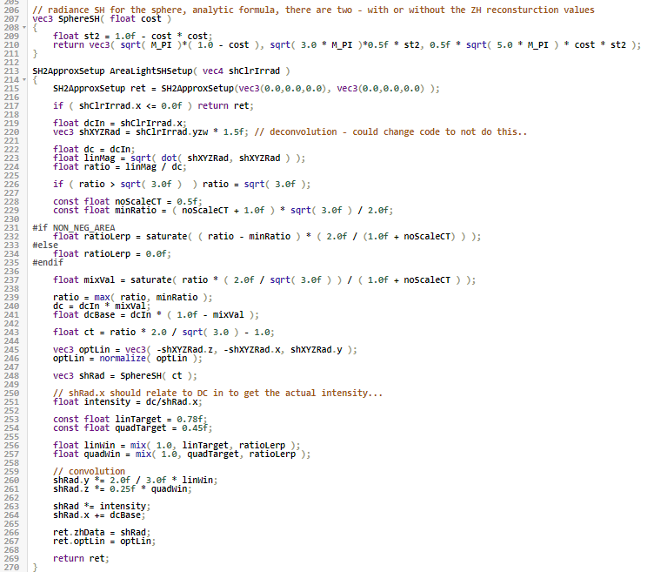
Linear SH To ZH Data
Notes:
So the code that converts linear SH to a ZH is on the right, but most of those instructions are just involving constants. You can see the shadertoy for details, this also has some optional de-ringing based on the ratio. This preserves the linear SH as well.
This generates the core data for a ZH lobe, the axis (optLin in the struct) and the coefficients for the ZH basis function. There is no need to blow the SH out to 9 coefficients.

Slide 79
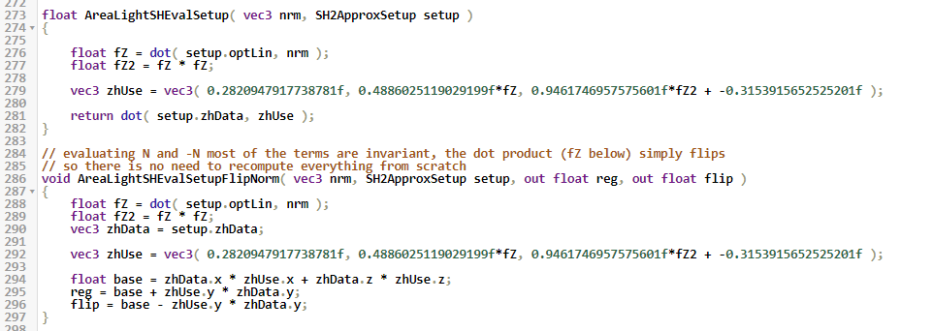
ZH Evaluation
Notes:
When you have this struct, evaluating for a normal is very simple. You just dot it with the SRBF axis, square that value, and then dot it with the precomputed ZH data.

Slide 80
ZH Evaluation
Notes:
Even better, if you want to use a simple transmission BSDF, a reflection cosine lobe and a transmission cosine lobe in the opposite direction, you can just break that dot product into parts:
[click]
The red box is the dot product of DC and the quadratic term, this is identical for a normal and anti-normal.
[click[
The blue box just adds +/- the linear part of the dot product.
This is not possible with Geomerics, since the dot product is added to one and inside a power function.

Slide 81
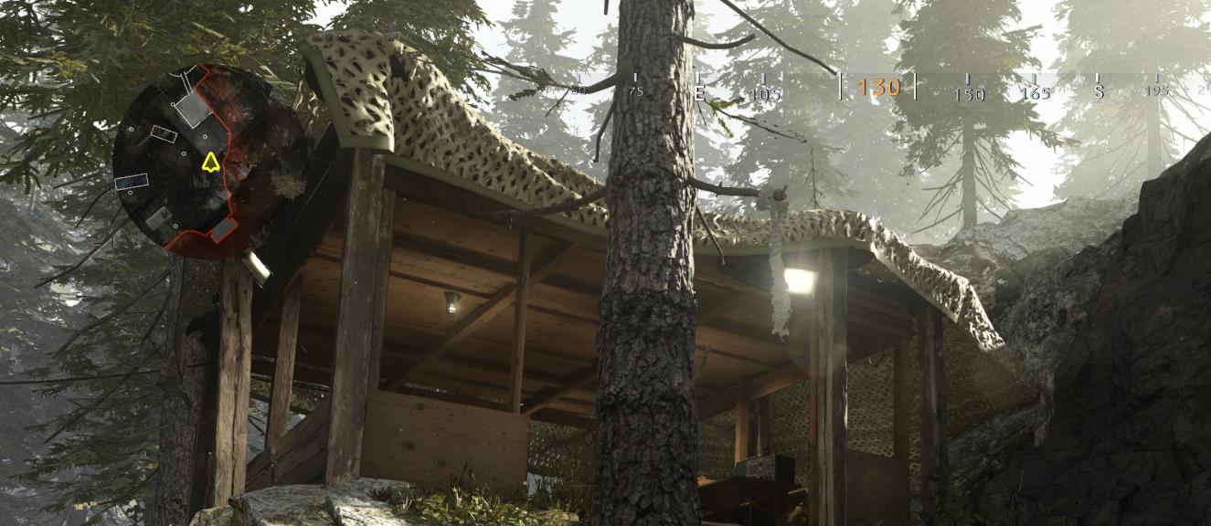
© 2020 Activision Publishing, Inc.
Notes:
Here I have some shots in the game, this is with materials.

Slide 82
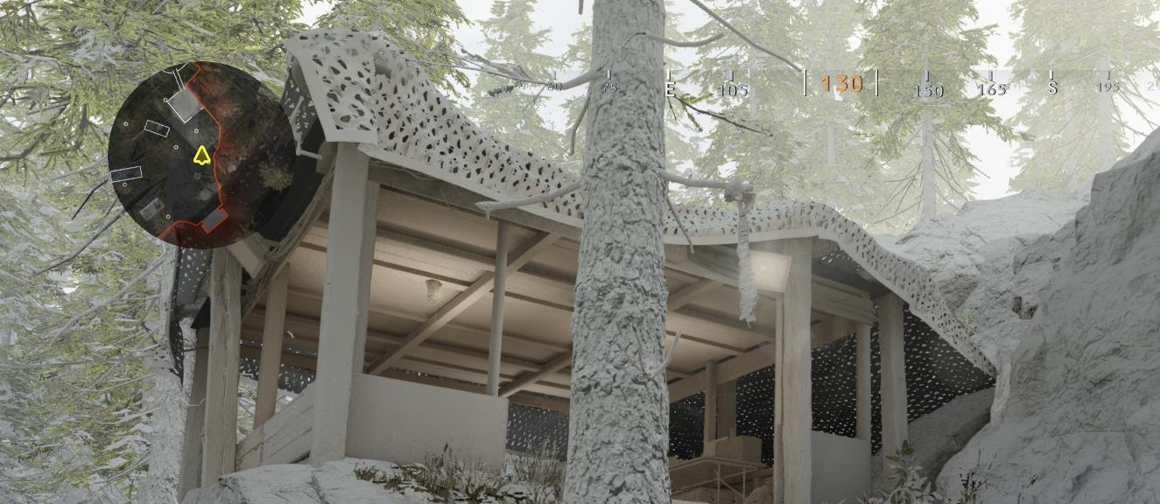
Vert
© 2020 Activision Publishing, Inc.
Notes:
Here is using our vertex shader projection, where it doesn’t work for the tarp – since it is 2 sided, the lighting is wrong on the back side.

Slide 83
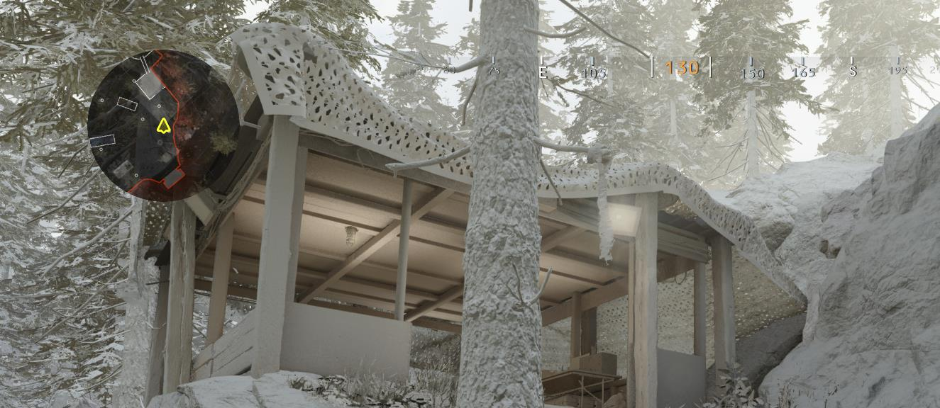
SH3
© 2020 Activision Publishing, Inc.
Notes:
Here is per-pixel SH3 (we only support that in a debug mode)

Slide 84
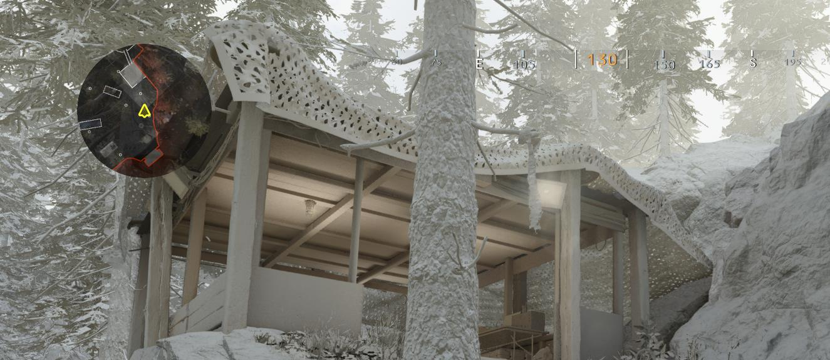
MAL
© 2020 Activision Publishing, Inc.
Notes:
Here is the reconstruction using a mixture of an ambient and spherical light with linear SH.

Slide 85
Shadertoy SH3
Notes:
I have a shadertoy that has two area lights, the yellow sliders are intensity and the purple one is size of the area light.
We have SH3

Slide 86
Shadertoy SH2
Notes:
SH2 – note the negative “hole” in the –Z hemisphere.

Slide 87
Shadertoy Geomerics
Notes:
Geomerics – you can see that overly soft tail in this example (the lights are fairly different)

Slide 88
Shadertoy New
Notes:
And our approximation. There is an option to window a bit, in practice we don’t do that too much, since our SH are already windowed as input, but it’s definitely something worth exploring.

Slide 89
Shadertoy Transmission
Notes:
Here is an example where we add the transmission lobe in as well. Just a green cosine lobe, you can play around with all of these in the shadertoy.
So tweaking this reconstruction some more is something I am actively looking into, the cheap transmission is one of the most attractive properties vs. Geomerics.
I have a link for both shader toys in the slides.

Slide 90
Dynamic Lightsets
Notes:
The final part of our talk is on dynamic lightsets, how we update our baked GI during gameplay.

Slide 91
Evolution of the Idea [Seyb20]
Previous system existed called “A/B” lighting, do a bunch of smoke and swap in new geo/lighting data.
Always resident, very painful to setup (sparingly used), had to mark up models/lights, seam where it turned off
Minimal user interaction, update lighting data structures in place, started with just light changes (2017) then added doors last year.
Static model lighting evolved with this in mind (sparser data, kill vertex baking, decouple from geometry.)
Notes:
As I said at the beginning, Dario has a talk in the technical papers program on the system, and this part will complement that going into some implementation details.
We have been moving towards a more dynamic system for a while. There was an old system called “A/B” lighting, that could swap geo/lighting out for a part of a map, usually while a bunch of smoke happened. It was always resident, painful to setup – you had to mark lights/geometry, there was often a seam when you turned it on/off, etc. It also made the bake more complicated than I would like.
Our goals to replace it were to make it simpler to use and update the lighting data we have instead of swapping all geo/etc. We first shipped this in 2017, but we were evolving towards these type of changes – this is part of the motivation for the static model evolution I referred to, and why we killed vertex baking.
[click]
This is a video from Call of Duty WWII, the first iteration of this tech was used in a handful of maps in this game.

Slide 92
Examples IN Call of Duty: Modern Warfare
Notes:
As I said before we had stealth game play mechanics, and needed to be able to update indirect lighting if you shot out, or turned off lights.

Slide 93
Light On
Notes:
Here is another example from the game, with the light on.

Slide 94
Light Shot Out
Notes:
And the light shot out – unsurprisingly things get dark when you turn the lights off. If we cranked the exposure you could see the light from the other room (which also can get shot out in this instance.)

Slide 95
Door Open no GI update
Notes:
We also had doors, here is an example of a dark room with the door open but GI updates from the door disabled.

Slide 96
Door Open GI Update [Seyb20]
Notes:
And here is with the lighting from the door.
Our systems paper describes how we arrived at this point, and details about sampling for doors. Please see that and Dario’s talk in the papers track at SIGGRAPH. I am going to cover more implementation details.

Slide 97
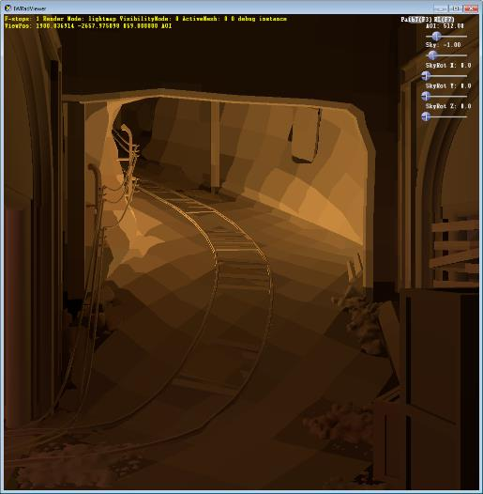
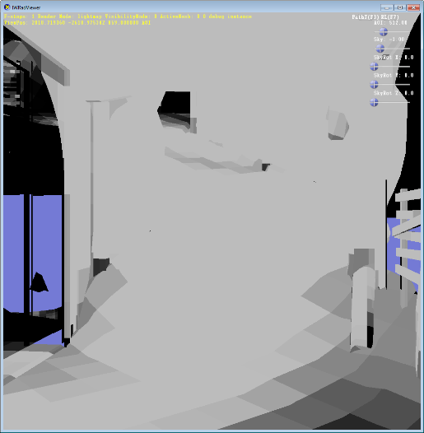
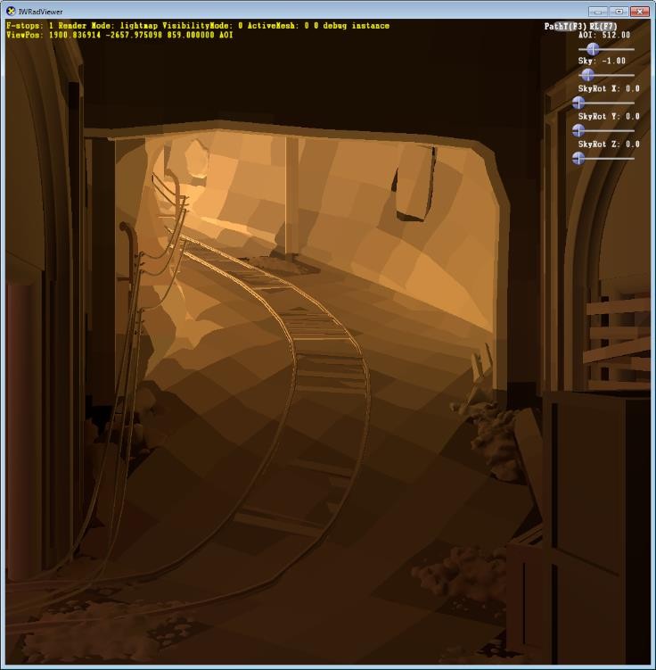
Two Light Sets
Control them independently, overlap significantly
Notes:
Here is a very early example from Call of Duty: WW2, there is a system of tunnels, and we show two sections that are in different “lightsets”, the left is combined lighting, the middle is each set on and the right are influence masks generated during the bake (so that when we limit the influence it doesn’t have a harsh transition.)

Slide 98
Challenge with Data
Notes:
Initially I started coding something up to track blocks of texels, but pretty quickly I realized that would be problematic. We have many small charts, the images on the left are lightmap tiles for one level, and on the right is the “influence mask” for a single lightset – it spread through 6 of the 7 lightmaps for this level (7th not shown.)

Slide 99
Lower Left Lightmap Tile Only
Notes:
Here is just one of the zoomed up. It’s spare, but not compact.
I will probably revisit this in the future, but it steered me to a different solution. In that game these 512x512 pages were later packed.

Slide 100
Workflow
Lights are tagged to be in a set
Often mix of bake only and run-time lights
Grouping reduces overhead, often controlled together (bank of lights)
Intensity set in the editor is “default”, average ratio of run-time light to editor light is “basis function” RGB
Lights can be removed from this average computation – ie: pull a buzzing light out, indirect won’t update from it
Bake Only
In Game Only
Notes:
The workflow for lighters is fairly straightforward. Lights are tagged to be in dynamiclightset. On the right we see a pair of light fixtures, that contains a static omni light and an in game light pointing down (so we don’t need an omni shadow map), so the baking includes the indirect response to both lights, and the direct response to the omni (so this is simulating the light leaving the fixture through the shade in particular.)
This helps with run-time performance, and the light above the fixture often isn’t interacted with by players/etc.

Slide 101
Workflow
Lights are tagged to be in a set
Often mix of bake only and run-time lights
Grouping reduces overhead, often controlled together (bank of lights)
Intensity set in the editor is “default”, average ratio of run-time light to editor light is “basis function” RGB
Lights can be removed from this average computation – ie: pull a buzzing light out, indirect won’t update from it
Bake Only
Left Off Bake Only
Notes:
Here we replaced the direct only with the baked lighting if you shoot one of the lights out.
Grouping lights reduces overhead.
In the editor, the lights still have the usual parameters, and this is what will be used to bake the sets later. At run-time, the average ratio of the current intensity of the light to the bake intensity is what is used to control the intensity of the baked lighting for that set.
There also are options to pull lights out of the “driving” set, for example you might want a bank of LED bulbs to be in a set that is turned on from the wall. If one of them is buzzing, the entire set would be needed to update every frame. It can be flagged to not drive, so there is no per-frame cost, just when the switch changes (or lights are shot out.)

Slide 102
Changes to Baking Code
Iterate over lightsets
Bake 2 “regular” bounces
Threshold indirect light in directly lit texels – determines cut-off intensity
Blur this mask (see [Seyb20] for details)
Only run final gather (most expensive part of bake) on non-zero mask
LG samples in volume of stored data
See Darios talk and the paper for sampling strategy for doors
Notes:
So the baking code is largely left alone, we do the regular bake, then we iterate over the lightsets, but we do so in a way to save performance.
We do two regular bounces over the entire map, then we analyze that data creating a threshold and a mask as was shown before, see the paper for details.
The important thing about this is we now have only a subset of the texels that require the final gather, which is where the bulk of the LM sampling cost is (ie: this is where ray guiding is used, and a huge fraction of the total rays…)
We also track the bounds of the active data, and use a bloated version of this to sample the LG – which helps quite a bit, the LG can be as much as half the bake time in a regular map depending on the quality setting.
See Darios talk and the paper for details on how we sampled the light paths for the doors.

Slide 103
Changes to Baking Code
# sets+doors | Fast | Ship
132 | 3.3x | 6.7x
61 | 2.1x | 2.6x
24+1 | 1.8x | 2.4x
14+3 | 1.3x | 1.9x
6 | 1.2x | 1.2x
Iterate over lightsets
Bake 2 “regular” bounces
Threshold indirect light in directly lit texels – determines cut-off intensity
Blur this mask (see [Seyb20] for details)
Only run final gather (most expensive part of bake) on non-zero mask
LG samples in volume of stored data
See Darios talk and the paper for sampling strategy for doors
Notes:
So there is some baking overhead, but nowhere near what the number of sets would imply (ie: 132 sets would be 132x as long otherwise), in fast the most complicated map took 3.3 times as long as having no sets, and on extra quality it was 6.7x. There is room for improvement here, optimistically maybe cut it by one fourth for these complex maps by handling multiple sets at a time.
Most campaign maps and many mp maps used this feature, but they tended to be on the lower end of lightset count I think there was one more map not shown here with around 50 sets, while the rest were often in single digits.
In the first game we talked about trying to keep to less than 10 sets (they went up to 26) and the second game

Slide 104
How to Encode Data?
LG and LGV are simple
SH Encoding only used for this at first
LM was more challenging
Read modify write resource issues
Bulk of the data
New LM format was initially only for DLS
Texel size half of LM at the time
Started by looking at how to add AHD lobes
Notes:
The LG and static model lighting were fairly straightforward to encode, you just need to store SH for the additional sets. The compact encoding was used, but actually not until later, since it cut the memory of the base SH representation in half.
The Lightmaps were the challenging part. I already showed that they were sparse, but there also are a lot of restrictions on read modify write with resources you want to use for lightmaps, particularly on our low end PC platforms. They also represent the bulk of the data.
The new lightmap format was initially only used to store lighting values for lightsets, it is half the size of the FP16 AHD format we shipped with in 2017 (8 bytes/texel.)
The format actually came about looking at how given two AHD samples, how do you add them and represent the result in AHD efficiently?
One take away from this is that optimizing the size of the GI update data, had a trickle-down effect each time – eventually replacing the representation we used everywhere in the game.

Slide 105
Obvious Choices
Texel Address 2B
x.y
Lighting 8B
Store data per lightset, blend as they change
Location in LM is half the memory of lighting data, redundantly storing is very expensive
RW resources have issues, extra bandwidth (old-school vs. modern deferred rendering)
Blend is non-linear, need code to do properly
Easy to disable lightsets, shaders would be simple
“Matrix Palette Skinning”
No RW, store # blends, bf index per texel
How to get start address? Fixed size?
Not GPU friendly – caches or SIMD
Hard to “skip work” if a lightset is off or not changing
BF Index 1B
N
# Blend 1B
N
BF 1
BF 2
27,12
27,12
28,12
28,12
29,12
30,13
31,13
31,13
…
…
Notes:
So the two obvious choices are either store all the values for a single basis function (shown here), where for each basis function you need to store the address and the payload – which for the LM is 8 bytes.
But there are a bunch of problems with this, one is the address is large relative to the payload, so if you have a lot of overlaps, there is a big redundancy.
A larger problem is that RW resources have serious limitations, particularly on PC hardware, where some platforms can only use 32bit float or integer formats, and nothing else.
Finally the blend while fairly simple, is not something that’s easy to setup in fixed function hardware. So you would have to do this in multiple passes anyways, kind of like old school deferred rendering that uses excessive bandwidth.
One positive is that it is easy to skip work for any lightset that happens to be off. The number of blends is never stored, and the basis function is implicit so also never stored.
Here we see an example of this, where each box represents a basis function (some starting address in a single buffer resource, or you could split out address too a separate buffer.) There are some redundant addresses where they overlap.
The basis function index is implicit in this case, it can be stored in a constant buffer per dispatch.

Slide 106
Obvious Choices
Texel Address 2B
x.y
Lighting 8B
Store data per lightset, blend as they change
Location in LM is half the memory of lighting data, redundantly storing is very expensive
RW resources have issues, extra bandwidth (old-school vs. modern deferred rendering)
Blend is non-linear, need code to do properly
Easy to disable lightsets, shaders would be simple
“Matrix Palette Skinning”
No RW, store # blends, bf index per texel
How to get start address? Fixed size?
Not GPU friendly – caches or SIMD
Hard to “skip work” if a lightset is off or not changing
BF Index 1B
N
# Blend 1B
N
27,12
1
2
28,12
1
2
29,12
1
X
X
30,13
1
X
X
31,13
1
2
…
Notes:
Matrix Palette skinning like storage is the other obvious choice.
You wouldn’t have any RW issues, you could simply write to the final resource (we have a backing channel for all texels).
You either have a fixed stride and wasted resource slots (which is inefficient black X’s in the above image), or a variable data structure that isn’t SIMD friendly, or you lose the ability to skip work easily (ie: if you have all 2 way blends in one buffer, all 3 way in another, etc.)

Slide 107
Hybrid Solution V0
Loft state to per dispatch constants
Which lightsets are used, number of lightsets in a dispatch
Ability to skip entire sets if they are zero – reconfigure constants
Shaders for 1/2/3 blends, all with same lightsets
Can demote if sets are off – all the way down to copy shader
Fall back shader > 3 blends
Copy to FP RW buffer (64k entries), do blends, copy back to final LM
Make indices implicit as much as possible
Toughest map on Call of Duty: Modern Warfare has 132 sets, optimized V0 code takes 20ms on PS4
Notes:
We ended up with a hybrid solution, in the first game we ended up with 5 basic shaders:
A copy shader that would just copy baking data into the lightmap if all the sets in a dispatch were off.
Shaders that blend 1, 2 or 3 basis functions (dispatch for each unique combination), these can be demoted since the dispatch constants set the basis function values and starting addresses for a stream. So a 3 way blend can be demoted to 2 if one of them is zero, just setting the constants differently.
The CB per-dispatch is shown here – it contains for each stream (this is 2 blends), the starting address in the buffer, and the basis function blend weights (setup before the dispatch) for each stream.
There is also the starting address in a buffer of addresses (2 bytes), this is also the starting address in a “backing data” resource, which is just a copy of the data with no basis functions, and a count on the number of records in the dispatch.
The basic idea is to move as much as possible out of per-texel data (basis function index, read addresses, etc.) and into small constant buffers setup on every dispatch. If you had a 3 way blend with a weight of zero, you simply setup the parameters and dispatch a 2 way blend, etc.
Finally there was a fall back shader for more than 3 blends, this was more involved, it copied data to a 64k scratch buffer (4 in flight to minimize transitions), would then do multiple blending passes, and finally copy back to the final resource. The indices, ie: inside this window, were implicit from shader indices as much as possible. The lighters were told to try and keep it under 3 overlaps if they could (and they mostly did on this game), though they were also told to have maybe at most 10 sets in a map, and I think the largest map had 26 when the game shipped.
[click]
I have a debug mode to run the shaders in regular compute and force every lightset to update every frame – this never happens during game play, but is good to measure worst case performance.
In this game the feature was used much more extensively. The toughest map had 132 sets, and they weren’t all independent. There is a mansion with almost every light that can be shot out. There also are giant flood lights outside that shine into the mansion and can be turned off or shot out, and a fire that happens at the end of the level where you have to run out of the mansion. With a slightly optimized version of the shaders, this was taking 20ms so I had to go back to the drawing board, the main culprit was the fall back shader and the number of overlaps.
But we also had a huge number of tiny dispatches, so the original algorithm to group the data just didn’t work – with that many sets, the number of unique combinations was just too large. On top of that, we wanted to add the doors opening/closing, so new we had to handle overlap better.

Slide 108
Hybrid Solution V1 Specialized Shader
Notes:
So we nuked the fallback shader completely. We wanted to have more fast paths, and be able to also have a reasonable minimum dispatch size for the compute shaders.
Instead of storing the basis function weights with each dispatch, we stored the basis function weights in a CB that is always bound,.
We optimized the size of the per-dispatch constant buffer to a single uint4, shown here. The number of texels, the starting address of the backing data, the starting address of the basis function data an extra uint that varies depending on the shader – for the one I am about to show it is a 3bit number per stream (up to 8) that encodes the starting address for each stream. This makes it easy to remove zero weight basis functions. There are 8 of these specialized shaders.
We do not store the basis function index in this CB, we freed up a byte that used to be the primary shadow mask, and just store the basis function index in that spot instead.

Slide 109
Hybrid Solution V1 Specialized Shader
Notes:
The shader just takes a relative index, and a uniform bool for each of the blends2-7, so it generates the proper code.
We see the actual shader specialized for 3 blends in the box. It dispatches in 1D, to minimize the instructions that generate addresses.

Slide 110
Hybrid Solution V1 Specialized Shader
Notes:
The generic shader is fairly straightforward, it only executes for lmoptNumTexels.

Slide 111
Hybrid Solution V1 Specialized Shader
Notes:
Then it loads the backing data – this 8 byte value can be loaded with a single instruction, and that helped perf compared to trying to use textures.

Slide 112
Hybrid Solution V1 Specialized Shader
Notes:
Then it blends in the first value, this is just the start address, plus the relative index in the shader + the stride [0,8] packed into 3 bits of the CB times the number of texels in this dispatch.

Slide 113
Hybrid Solution V1 Specialized Shader
Notes:
It then blends the additional blends, just unpacking a different 3 bit stride for each.

Slide 114
Hybrid Solution V1 Specialized Shader
Notes:
Before computing the output address, the “lmoptSharedRoot” is used for the streaming texture atlases, where the lightmaps are re-packed into a dynamic atlas.
Since we can store the basis function index in each texel, we can pack any N way blends (up to 8) into this same shader

Slide 115
Small Dispatch Solution
Since we store BF index in the texel, any N blends from [1,8] can use the exact same shaders, just lose the ability to demote
Any unique blend combination with < 64 texels uses this path
Want to minimize the total number of basis functions in a dispatch (so it fires as infrequently as possible.)
Clustering problem assuming M-sets
Any unique blend is a bit vector in an M-bit number, and has a “weight” that is the number of texels
Maximize the sparsity, put all records with N blends in a single cluster, split until you have enough records (at least 128), or hit a target sparsity (unique BF in the cluster.)
Can still have “unique blends” left after this, if <= 4 blends, just use the smaller dispatch
Ie: 17 5-way blends, 10 6-way blends, 4 7-way
Notes:
So we still have the “small dispatch” problem, we have 3 final types of shaders to address this.
You can collect all texels with the same number of blends, and simply merge the data in a format that can’t skip any work. In practice we require a minimum of 64 texels to make a dispatch worth it (one console wavefront.)
When we merge records, we want to minimize the number of basis functions that exist in a dispatch (a dispatch has to fire if any basis functions changed, so we want to minimize that probability.)
We solve this as a high dimensional clustering problem. If you have M sets (132 in the largest example), you can think of a unique set of blends as a bit-vector in M dimensional space. You also have a “count” for that point, the number of texels (that must be < 64 if we are still trying to do something with it.) You treat this as a clustering problem, where for say all the 6-way blends you start out with a single cluster, and split it until a child has enough records or hit’s a target sparsity (number of unique BF – I think I use around double the number of blends.)
Unfortunately we can still have a bunch of small records after doing this, ie: we might have only 17 5-way blends, 10 6-way blends and 4 7-way blends.
For our most challenging map, we show a histogram of the blend counts, most of the texels are <= 4, but there are a non-trivial number with these higher overlap counts even above 8.

Slide 116
Last Specialized Shaders
Support “variable length” records, with minimal storage overhead (5-8 blends, 9-16 blends)
Sub-sampled arrays:
optPallette: 2 bit number per texel, number of values > 5 (0,1,2,3), 32 bit value for 16 texels (2bits/texel)
optSkip: prefix-sum of optPallette for all texels before your “group”, 16 bit value (1bit/texel)
Notes:
So we have two final shaders that deal with variable length data structures, one for 5-8 blends, and one for 9-16 blends.
We want fixed access patterns and minimal branching in the shaders. So we store two sub-sampled arrays. In the 5-8 shaders they are down sampled by 16, and by 8 in the 9-16 blend shader.

Slide 117
Last Specialized Shaders
Support “variable length” records, with minimal storage overhead (5-8 blends, 9-16 blends)
Sub-sampled arrays:
optPallette: 2 bit number per texel, number of values > 5 (0,1,2,3), 32 bit value for 16 texels (2bits/texel)
optSkip: prefix-sum of optPallette for all texels before your “group”, 16 bit value (1bit/texel)
Notes:
We have a 2bit-code for each texel, which is the number of blends above 5, this amortizes out to 2 bits per texel, the “relIndex shifted right by 4” is the group of 16 texels you belong to.

Slide 118
Last Specialized Shaders
Support “variable length” records, with minimal storage overhead (5-8 blends, 9-16 blends)
Sub-sampled arrays:
optPallette: 2 bit number per texel, number of values > 5 (0,1,2,3), 32 bit value for 16 texels (2bits/texel)
optSkip: prefix-sum of optPallette for all texels before your “group”, 16 bit value (1bit/texel)
Notes:
We also have the prefix sum, ie: the number of texels above 5, for all of the texels before you. This is a 16bit number, so it amortizes out to 1 bit/texel. But again, only for the texels that couldn’t be dispatched with the specialized shaders.

Slide 119
Last Specialized Shaders
Support “variable length” records, with minimal storage overhead (5-8 blends, 9-16 blends)
Sub-sampled arrays:
optPallette: 2 bit number per texel, number of values > 5 (0,1,2,3), 32 bit value for 16 texels (2bits/texel)
optSkip: prefix-sum of optPallette for all texels before your “group”, 16 bit value (1bit/texel)
Notes:
You can determine which 2 bit code you need to lookup by masking off all but the lest 4 bits, and extract the 3 bits which is your “extra count”, this will probably map to a bitfield extract instruction.

Slide 120
Last Specialized Shaders
Support “variable length” records, with minimal storage overhead (5-8 blends, 9-16 blends)
Sub-sampled arrays:
optPallette: 2 bit number per texel, number of values > 5 (0,1,2,3), 32 bit value for 16 texels (2bits/texel)
optSkip: prefix-sum of optPallette for all texels before your “group”, 16 bit value (1bit/texel)
Notes:
You then need to compute a prefix-sum of all the texels before you, this is by done masking all the bits higher than yourself and yourself.

Slide 121
Last Specialized Shaders
Support “variable length” records, with minimal storage overhead (5-8 blends, 9-16 blends)
Sub-sampled arrays:
optPallette: 2 bit number per texel, number of values > 5 (0,1,2,3), 32 bit value for 16 texels (2bits/texel)
optSkip: prefix-sum of optPallette for all texels before your “group”, 16 bit value (1bit/texel)
Notes:
This line of code computes the prefix sum of the 2 bit counters before us.
This isn’t the first thing I tried, so I will go into a short digression.

Slide 122
Last Specialized Shaders (digression)
Support “variable length” records, with minimal storage overhead (5-8 blends, 9-16 blends)
Sub-sampled arrays:
optPallette: 2 bit number per texel, number of values > 5 (0,1,2,3), 32 bit value for 16 texels (2bits/texel)
optSkip: prefix-sum of optPallette for all texels before your “group”, 16 bit value (1bit/texel)
Notes:
My initial thinking was that truncating the “top” of the log reduction way to count bits in a 32 bit number would be the way to go.
If you aren’t familiar with that, I have the 8 bit version of the code on the slide. You think of it as 8 1bit counters, you then shift the odd bits over and add them masked off with the even bits, creating 4 2 bit counters.
Each step halves the number of counters and doubles the number of bits (there would be 2 more steps for a 32 bit number.)
If I already start with several 2 bit counters, you could just jump into this algorithm later. I think if your counters are more than 4 bits wide (in a 32 bit number), this is the way to go.

Slide 123
Last Specialized Shaders (digression)
Support “variable length” records, with minimal storage overhead (5-8 blends, 9-16 blends)
Sub-sampled arrays:
optPallette: 2 bit number per texel, number of values > 5 (0,1,2,3), 32 bit value for 16 texels (2bits/texel)
optSkip: prefix-sum of optPallette for all texels before your “group”, 16 bit value (1bit/texel)
n bit number is: $\sum_{i=0}^{n−1}{b_{i}2^{i}}$
0x5 = 0101, 0xa = 1010
Pallette: 00 10 01 01
Sum = countbits(00 00 01 01) +
countbits(00 10 00 00) * 2;
Notes:
But GPU hardware has bitcount instructions, so for small number of bits (like 2 to 4), it’s faster to think of binary numbers as place-value numbers, for 2 bits you have the even bits multiplied by 1 and the odd bits multiplied by 2.
This is what that line of code does.

Slide 124
Last Specialized Shaders
Support “variable length” records, with minimal storage overhead (5-8 blends, 9-16 blends)
Sub-sampled arrays:
optPallette: 2 bit number per texel, number of values > 5 (0,1,2,3), 32 bit value for 16 texels (2bits/texel)
optSkip: prefix-sum of optPallette for all texels before your “group”, 16 bit value (1bit/texel)
Notes:
The base address for this texel is the base address for the dispatch + 5 * the texel index (every texel has at least 5 blends in this shader, no reason to eat into our limited space to encode that) + prefix sum of all the prior groups of 16 texels + the prefix sum computed above.
The 9-16 shader is similar, except you need a 3 bit code, and 3 countbits instruction, the next one multiplied by 4.

Slide 125
Specialized Shader for 5-8 and 9-16 blends
Notes:
The shader shared by both 5-8 and 9-16 blends is shown here. This is pretty similar to the base specialized shader. One thing it does do is use a load4 instruction to load a pair of lightmap texels, which is faster than issuing 2 load2 instructions. As I said before we seem to be limited by the number of fetch requests pretty frequently.

Slide 126
Performance
Most of the time nothing changes, so it’s free
The V0 shaders on the most challenging level (132 sets) when forced to update every frame and not in async take 20ms, the optimized shader is 1.47ms (<< 20+ms, win!)
Other optimizations
In a dispatch, offline sort records by destinations memory address (API’s for consoles, Morton code for PC), this saves a couple percent vs. raster scan
Skip lightmaps / models that are not streamed in
Could look at visibility, but would require careful tracking of when state was last updated
Notes:
Most of the time nothing changes, so there is no cost.
As I said before, I have a debug stress test that forces every lightset to be updated every frame and does not use async (so it’s easy to measure perf), in the worst case this took over 20ms in the V0 shader, but now is only 1.47ms on PS4. The other levels are all quite a bit faster in the worst case.
One other optimization we do is to sort the records in a dispatch by memory address, there are console API’s to get this information, and you simply reshuffle the data. We skip data that is not streamed in, and we could try and use visibility to update sets or dispatches, but that requires more complicated tracking (to see if a basis function has been updated since it was last scene, etc.) and wasn’t necessary yet.

Slide 127
Doors
[Seyb20] has sampling strategies
Shaders are oblivious, instead of average ratio use quaternion dot product
Optional parameter to determine how open the door is to treat “fully open”
“product basis functions” (dynamic lightset going through a door), where the weight is doorBF * DLSBF, but they came in late and are disabled – every door/DLS combination could add a new BF
Notes:
All of the run-time shaders are oblivious to doors. To generate the basis function values for a door, we simply take the dot product of the quaternion compared to the rest pose, this gives us cos(angle/2), we setup constants in the linker to cause the weight to lerp to 1 at a specified opening angle, with the default being 90 degrees. We also don’t start blending for very small fluctuations.
Doors and dynamic lightsets can be composed in the bake, where a new “product” basis function is created – the weight for these is the doorBF times the lightset basis function, but support came in late and they are disabled.
I am not sure we have any doors where this would be in play, but we plan to support it in the future.

Slide 128
Miscellaneous Issues
Dynamic models use exponential smoothing to blend in lighting, if light shuts off/on very distracting
Disable temporal update when this occurs, just replace instead
What about reflection probes?
Use variant of irradiance normalization [Lazarov13], divide by irradiance when rendering probes, multiply by local irradiance when fetched
Local irradiance comes from LM, LGV or LG (FX), this has already been “corrected” for lighting changes
Bake intensities for dynamic light sets should generally be neutral color, particularly if the light can change color – a hard zero would kill a color channel
Notes:
One final comment is that we use the standard exponential smoothing to blend in lighting for dynamic models, this works great most of the time, but when a lightset is turned on or off, having the dynamic models slowly lerp to the new steady state is very distracting. We simply detect this and disable the exponential smoothing when that occurs for a couple of frames.
One question you might ask is what about reflection probes? We have used a variant of irradiance normalization proposed by Lazarov, this just means the cube map divides each texel by the irradiance when it is created, and you multiply by local irradiance when fetching from the cube map.
This local irradiance comes from either a LM or a LGV, that have both been modified based on the real-time lights, this does a reasonable job of re-exposing the reflection probes. For things like destruction we probably would want to re-render or encode updates directly into reflection probes instead.
Finally, the default intensities used during the bake should be fairly neutral in color. If you set a color channel to a hard zero, it can not be “fixed” at run-time, since all that data was killed when baking out the lightset.

Slide 129
What Next?
Push on dynamic changes
Blowing variable sized holes in walls
Time of day
Scripted destruction?
Compress the data more
Improve baking times
Make it first class with streaming
Delete data if an event occurs that can’t change (update base records?)
Investigate using visibility to do even less work, or amortizing over time
Notes:
We have a couple of directions we want to push this in the future. More dynamic changes are an obvious one, blowing holes in walls, dynamic time of day and larger scripted destruction sequences are examples.
It should be possible to compress the lighting data more aggressively and I already mentioned some low hanging fruit to improve baking times when there are a large number of sets.
We have very limited support for streaming now, one useful feature would be to know if a set is in a state where it can’t be updated anymore (light completely shot out, etc.) if this is the case, we should be able to free up some memory and more importantly skip work by updating the backing data.

Slide 130
Acknowledgements
Studios: Infinity Ward, Sledgehammer, Raven, High Moon, Beenox
Lighters: Dave Blizard, Vivian Ding, Leandro Do Amaral, Rachel Donnelly, Christina Ellerby, Samuel Fradette, Alberto Noti, Angel Orlando, Andrew Prince, Velinda Reyes, Luka Romel, Marko Vukovic, Krzystof Wojcik
Developers: Danny Chan, Michal Drobot, Stephanus Fnu, Peter Pon
CT: Adrien Dubouchet, Aki Hogge, Michal Iwanicki, Jorge Jimenez, Josiah Manson, Dario Seyb, Andrew Shurney, Michael Vance
Notes:
I just want to re-iterate that there are a ton of really talented people we worked with on this game.

Slide 131
References
Shadertoy with Delta Functions: https://www.shadertoy.com/view/3ljyRt
Shadertoy with Reconstruction: https://www.shadertoy.com/view/WlBcWy
[Ari19] Ray Guiding for Production Lightmap Baking, Ari Silvennoinen and Peter-Pike Sloan, SIGGRAPH Asia Technical Briefs, 2019
[Chan18] Material Advances in Call of Duty: WWII, Danny Chan, Advances in Real-Time Rendering in Games, SIGGRAPH 2018
[Hazel17a] Alternate definition of Spherical Harmonics for Lighting, Graham Hazel, Blog Post 2017
[Hazel17b] Converting SH Radiance to Irradiance, Graham Hazel, Blog Post 2017
[Iwanicki17a] Precomputed Lighting in Call of Duty: Infinite Warfare, Michal Iwanicki and Peter-Pike Sloan, Advances in Real-Time Rendering in Games, SIGGRAPH 2017
[Iwanicki17b] Ambient Dice, Michal Iwanicki and Peter-Pike Sloan, EGSR EI&I 2017
[Lazarov13] Getting More Physical in Call of Duty: Black Ops II, Dimtar Lazarove, Physically Based Shading Course, SIGGRAPH 2013
[Seyb20] The Design and Evolution of the UberBake Light Baking System, Dario Seyb, Peter-Pike Sloan, Ari Silvennoinen, Michal Iwanicki and Wojciech Jarosz, SIGGRAPH 2020
[Sloan18] Directional Lightmap Encoding Insights, Peter-Pike Sloan and Ari Silvennoinen, SIGGRAPH Asia Technical Briefs, 2018
[Wyman89] Similarity Relations for Anisotropic Scattering in Monte Carlo Simulations of Deeply Penetrating Neutral Particles, Douglas R. Wyman, Michael S. Patterson and Brian C. Wilson, Journal of Computational Physics, 1989
[Zhao14] High-Order Similarity Relations in Radiative Transfer, Shuang Zhao, Ravi Ramamoorthi, Kavita Bala, SIGGRAPH 2014

Slide 132
Helper Functions
Notes:
I have some of the helper functions here for completeness, see [sloan18] for derivations behind these. The load is a load2 (faster than using texures), and whichBF is the 8bit basis function index, and bfDataVals[] is a buffer of float4’s with the current basis function weights.

