Slide 1
Sparse Shadow Tree
Kevin Myers

Slide 2
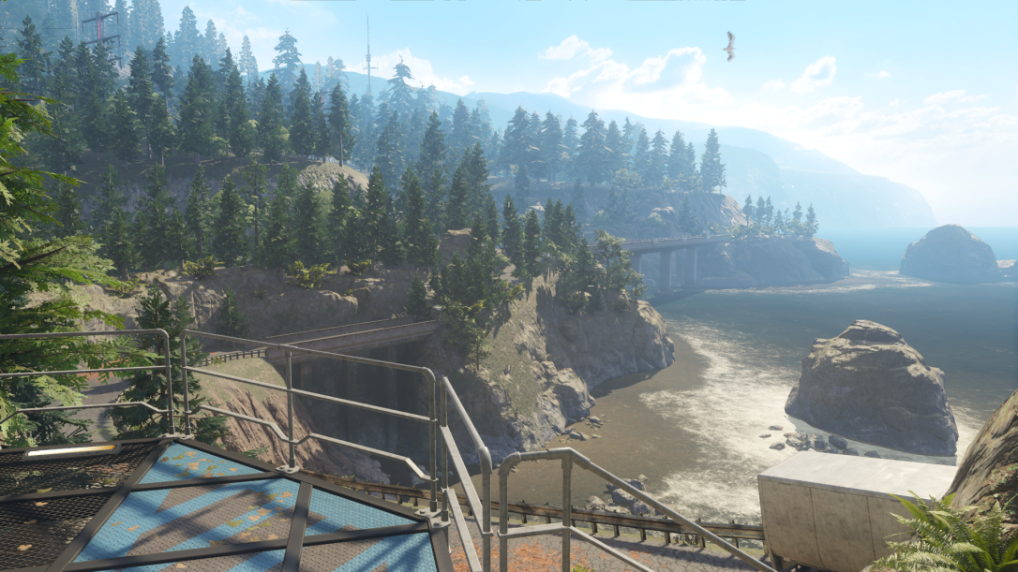
Sun shadowing
Special challenges
Scale
Miles of coverage vs feet
Intensity
Shadows a must
Special benefits
Orthographic
No perspective aliasing
Linear Z
Moves slowly
Baking/caching works well
© 2015 Activision Publishing, Inc.

Slide 3
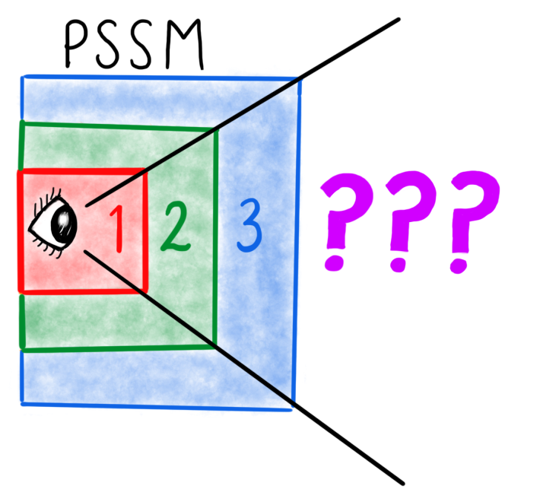
Sun shadowing
Parallel split shadow maps (PSSM) [Zhang2006]
Gold standard
Handles dynamics
Great near-mid range
Finite though….
Add in some baked visibility
2D - “Lightmaps”
Unique parameterization
Don’t shadow dynamics
Need to blend with PSSM
3D
“Compact precomputed voxelized shadows” [Sintorn2016]
“Compressed Multiresolution Hierarchies…” [Scandolo2016]
Unique parameterization
Don’t shadow dynamics
Need to blend with PSSM

Slide 4
Unified solution

Slide 5
Unified solution

Slide 6
Unified solution

Slide 7
Unified solution

Slide 8
Unified solution

Slide 9
Unified solution

Slide 10
Unified solution

Slide 11
Unified solution

Slide 12
UNIFIED SOLUTION

Slide 13
UNIFIED SOLUTION

Slide 14
UNIFIED SOLUTION

Slide 15
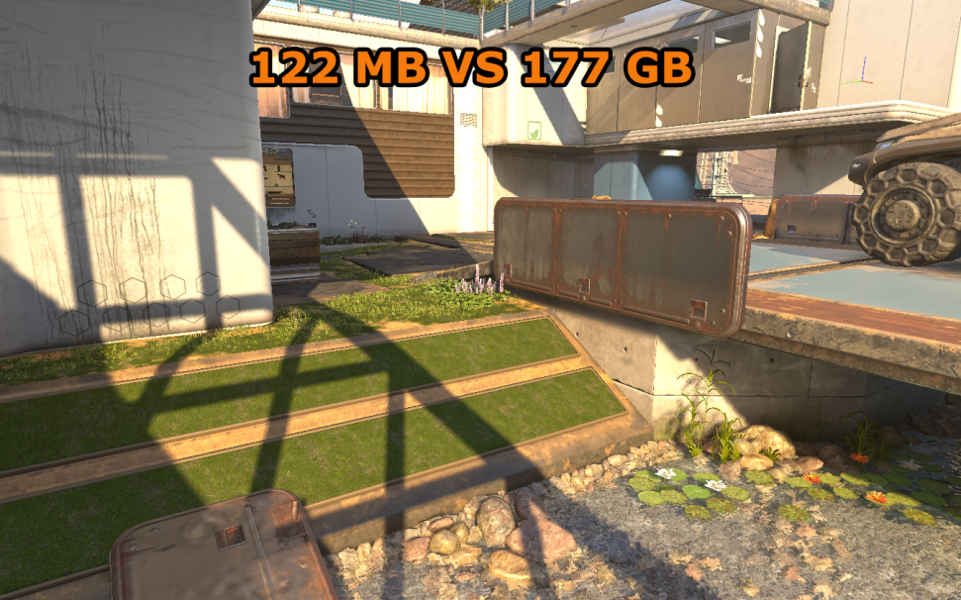
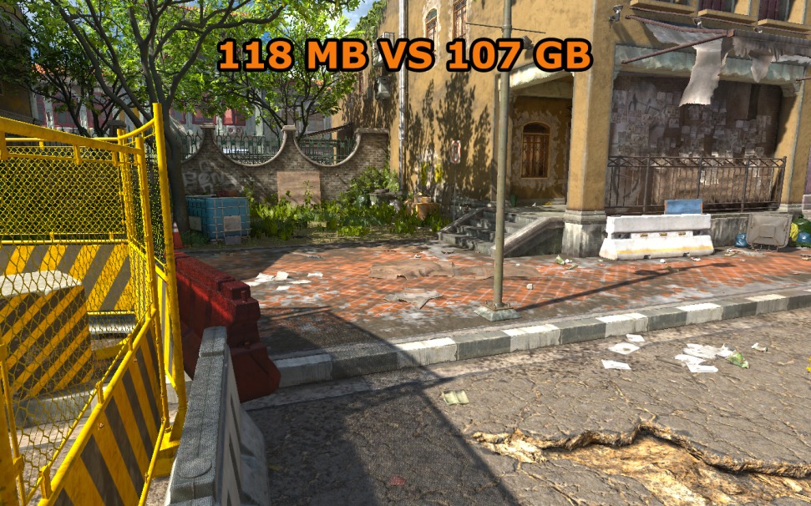
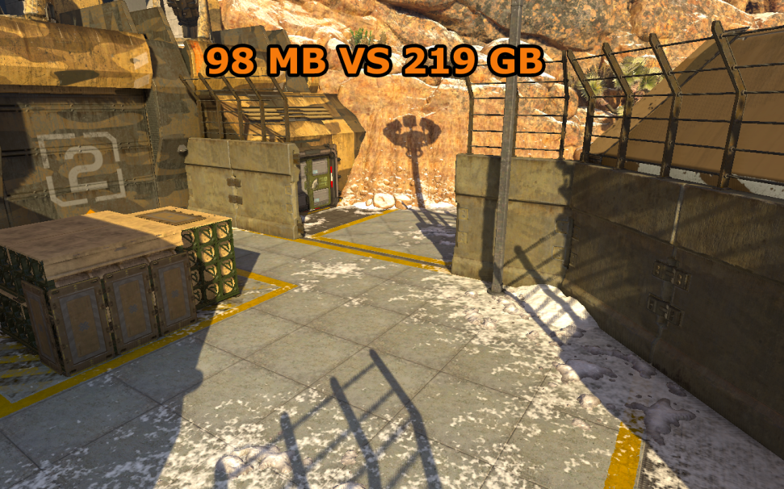
Sst results
431k x 220k
261k x 219k
© 2015 Activision Publishing, Inc.
404k x 290k

Slide 16
SST
Compressed depth map
No unique parameterization (GBuffer friendly)
Full replacement for static geo
Uses outside of lighting (FX placement)
Fast bake times
GPU raster leveraging production materials
CPU threaded compression
< 1 min for production maps
High compression ratios
Variable, typically 1000 to 1
Fast runtime
Direct access in lighting shaders
Compute shader (async) decompress

Slide 17
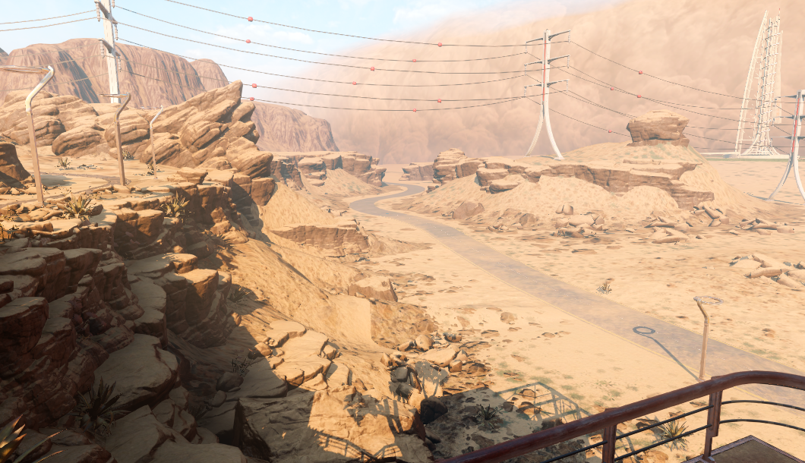
Compressing depth maps
Problem is non-uniform
Geometric complexity varies based on scene
© 2015 Activision Publishing, Inc.

Slide 18
Compressing depth maps
Problem is non-uniform
Geometric complexity varies based on scene
Texel density requirement varies based on view
© 2015 Activision Publishing, Inc.

Slide 19
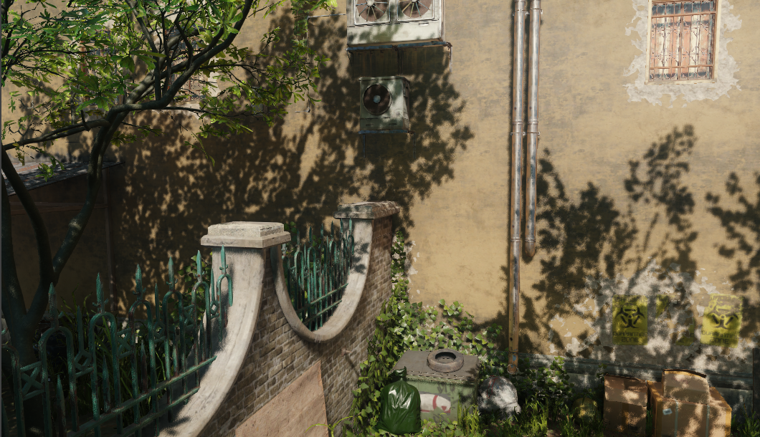
Compressing depth maps
Problem is non-uniform
Geometric complexity varies based on scene
Texel density requirement varies based on view
Shadow edge importance varies based on projection
© 2015 Activision Publishing, Inc.

Slide 20
Compressing depth maps
Data structure should harness this variability
Suggests some sort of tree encoding
Inherently depth function is a plane
depth = 2d gradient
depth = ddx * x + ddy * y + zOffset
Let’s do a quadtree of planes….

Slide 21
Quadtree of planes

Slide 22
Quadtree of planes

Slide 23
Quadtree of planes

Slide 24
Quadtree of planes

Slide 25
Point cloud generation
GPU produces shadow tiles
Production shaders respecting alpha test et cetra

Slide 26
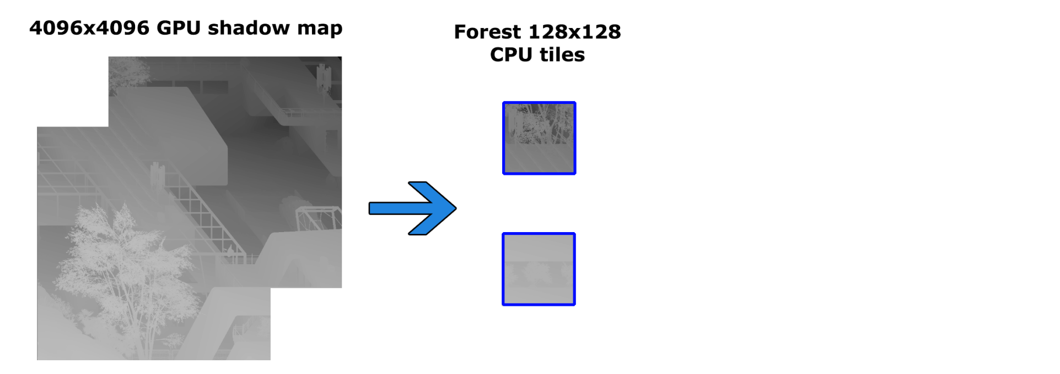
Point cloud generation
GPU produces shadow tiles
Production shaders respecting alpha test et cetra
CPU breaks up shadow tile
Root SST tile size

Slide 27
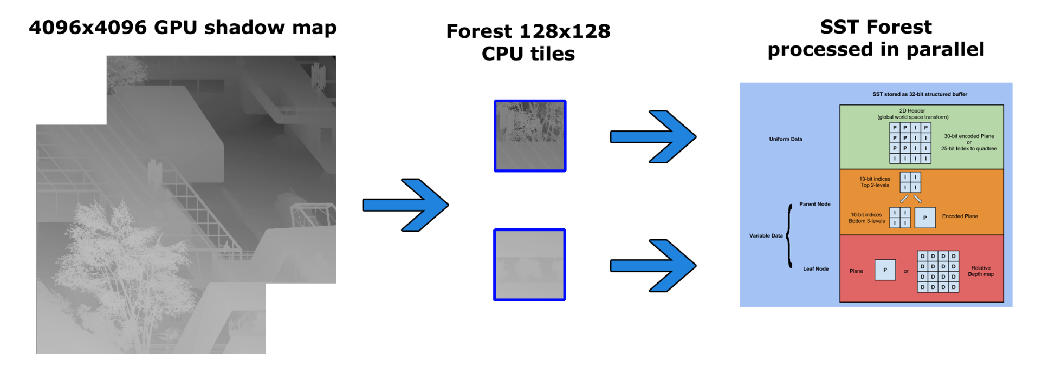
Point cloud generation
GPU produces shadow tiles
Production shaders respecting alpha test et cetra
CPU breaks up shadow tile
Root SST tile size
SST Tiles compressed in parallel
Readback pipelined and non-blocking

Slide 28
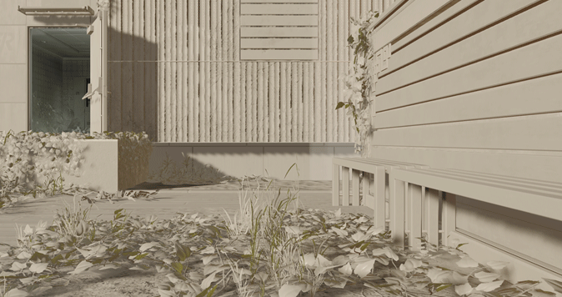
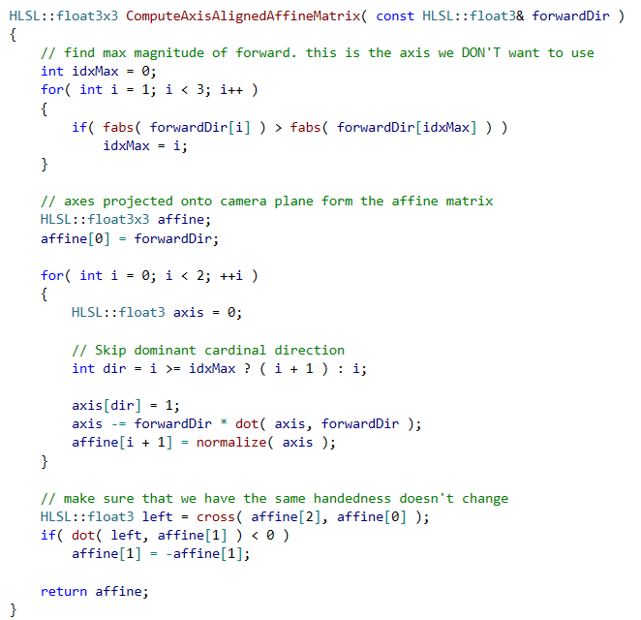
Affine transform
“Sheared” projection matrix
Aligns projection to cardinal axis
Reduces aliasing
Improves compression

Slide 29
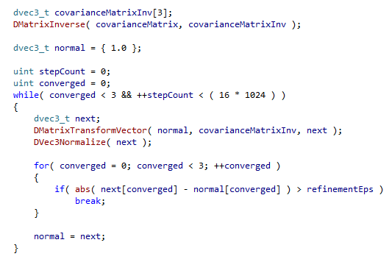
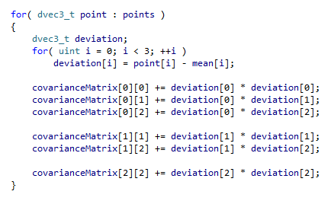
Fitting planes
Need to find normal of cloud
Non-dominant direction
Use Principal Component Analysis (PCA)
Compute 3x3 covariance matrix
Invert covariance matrix
Find smallest eigenvector (normal) via power approximation

Slide 30
Fitting planes faster
PCA is very precision hungry
Summing squares + determinant for inversion
Everything in double
Power approximation slow to converge
In practice we limited it to 16k iterations!!!
Highly parallel saturating the CPU
Still takes 2 – 5 minutes for production levels
Can do better….

Slide 31
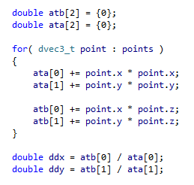
Fitting planes faster
PCA is overkill given our input data
Our point clouds aren’t that “cloudy”
2 of 3 dimensions (x and y) are well defined
Can remove all x y variance by centering grid
Find gradient ddx and ddy for z
Least squares minimization problem
Starting point for final solution

Slide 32
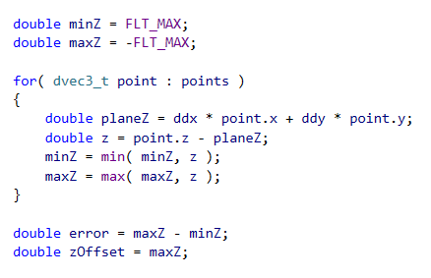
Fitting planes faster
Compute Z at every point given ddx ddy from LSQ
Z range defines accuracy of fit
If large (> 2“) reject and subdivide
If close apply grid search to refine

Slide 33
FITTING PLANES FASTER

Slide 34
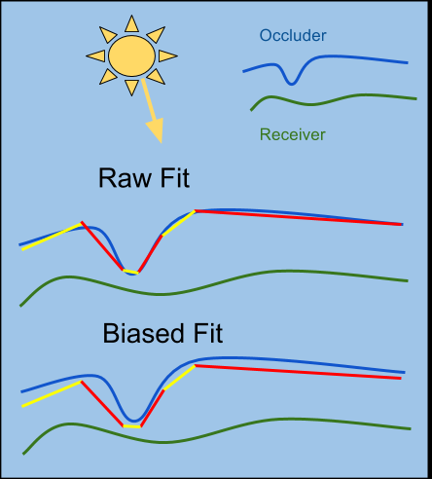
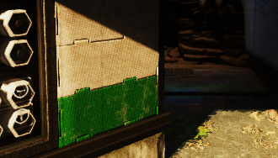
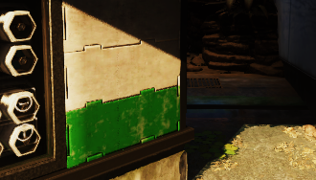
Biasing solution
Planes biased “down”
Avoid self shadowing
Tolerance driven by bake
Ratio of texel density
Allows baking acne away

Slide 35
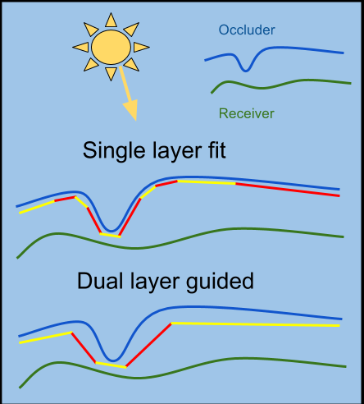
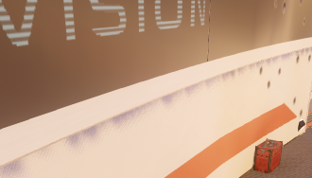
Biasing solution
Second depth layer
Estimates occluder
Better compression
Artist toggle for edge cases
Small curved details

Slide 36
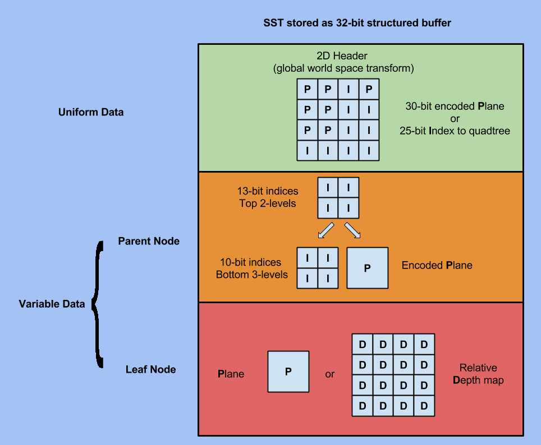
tree encoding

Slide 37
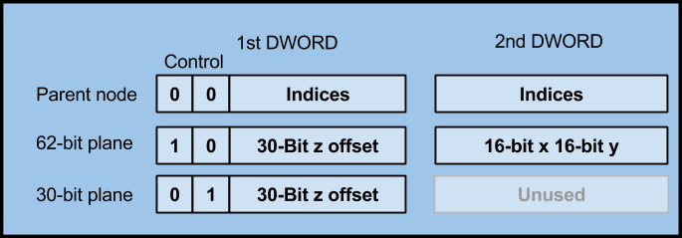
Encoding the tree
Encoding precision additional source of error
Given best least squares fit
Encode into final node format
Test again for accuracy of fit
Final encoding 64-bits
fp16 for ddx and ddy
fp30 for z offset
2 control bits

Slide 38
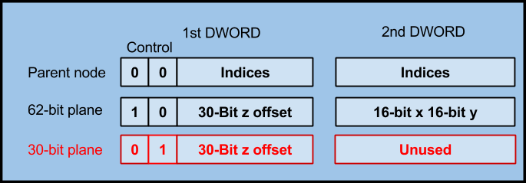
Encoding the tree
30-bit plane
Optimization for regions of constant Z
Gradient DWORD is unused
Actually encodes non-related nodes
Assumed 0

Slide 39
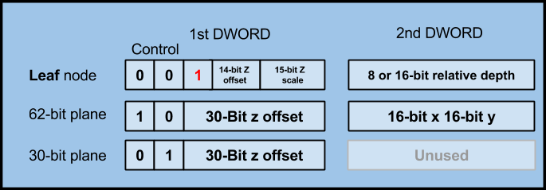
Leaf node
4x4 terminal case
Plane
Relative shadow map
Global offset/scale
8 or 16 bit
Select with additional control bit

Slide 40
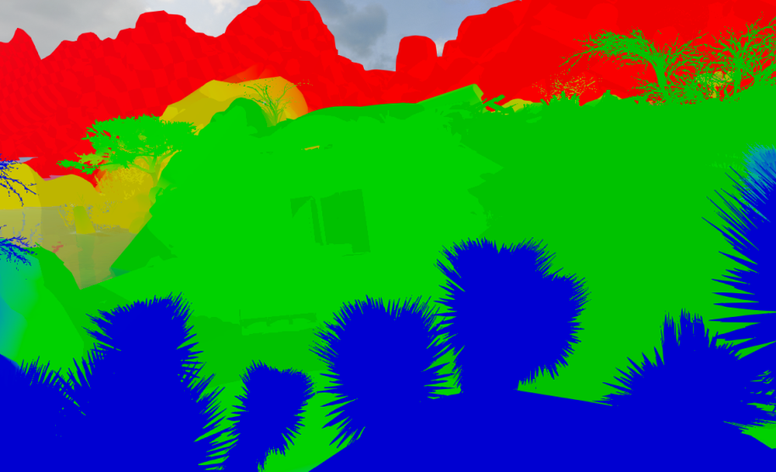
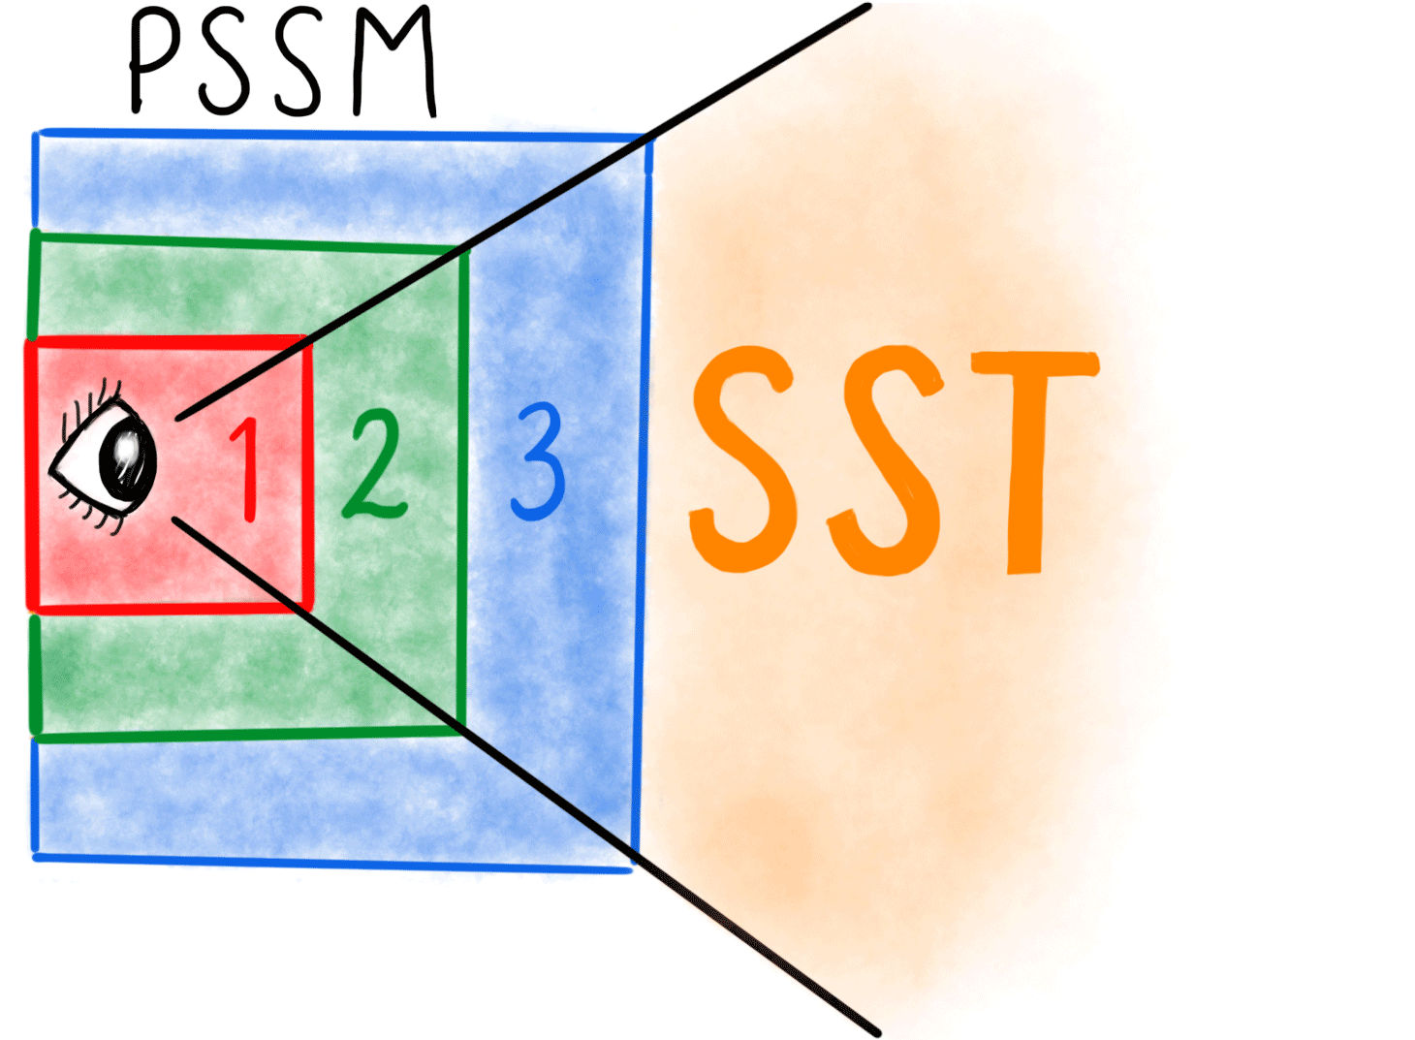
SST PIPELINE
Artist specify PSSM distance
Bounds far split texel density
Near splits are pow2 drops
Bake global SST at far split density
Provides all far shadowing
~25-35% of total space
Bake “gameplay” SST at near split density
Pow2 scale ensures holes can be filled

Slide 41
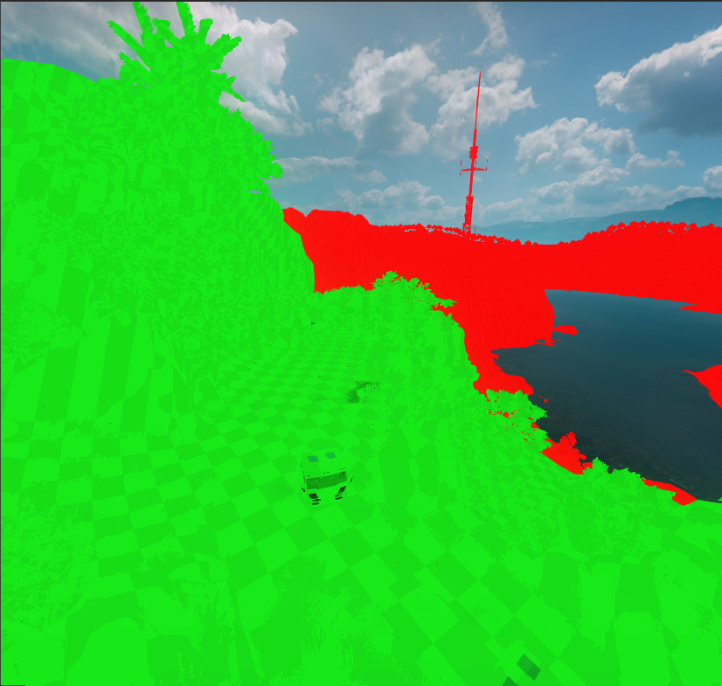
Sst pipeline
Gameplay area automatically seeded
Estimated via GI density
Artist can tweak
Gameplay area is green

Slide 42
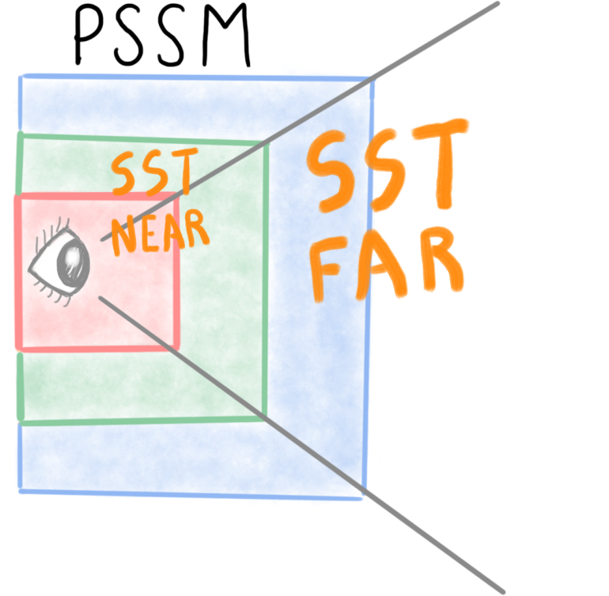
Sst runtime
2 SST Forests Streamed to Runtime
Gameplay @ near split res
Global @ far split res
Gameplay SST hole fill
Header re-indexed to global forest
Combined SST read by CS
Replaces shadow clear
.12 ms per PSSM Split

Slide 43
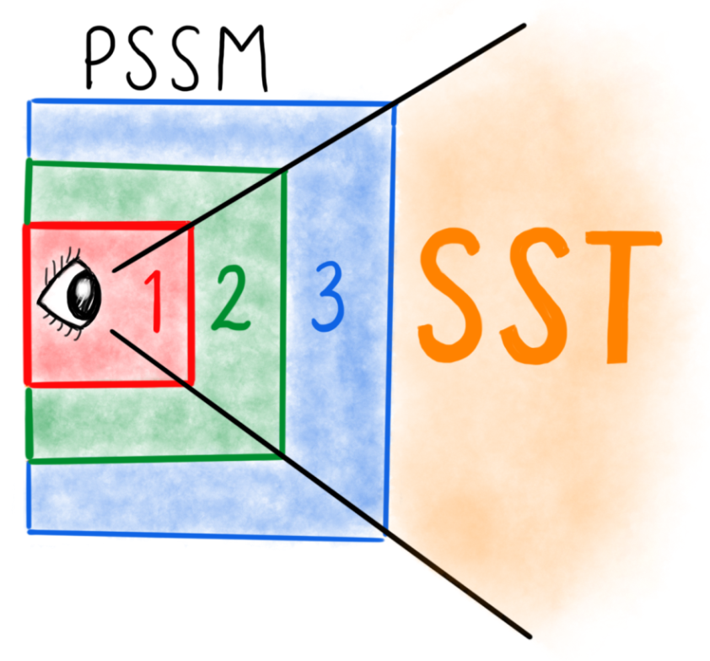
Sst runtime
Shadow past PSSM
Read global SST in lighting shaders
Transform to global shadow space
Convert to morton code
Walk SST forrest

Slide 44
Future work
Move compression to GPU
Plane fit highly parallel
Real-time compression
“Time of day” situations
Extend to local lighting
Improve dual-layer optimizations
Reduce error
Backfaces?
Evaluate surface
kmyers@treyarch.com

Slide 45
Special thanks
Josiah Manson
Treyarch Graphics Team
Activision Central Tech

Slide 46
rEFERENCES
[Sintorn2016]
Compact precomputed voxelized shadows.
[Scandolo2016]
Compressed Multiresolution Hierarchies for High-Quality
Precomputed Shadows
[Zhang2006]
Parallel splitshadow maps for large-scale virtual environments

